Slide 1
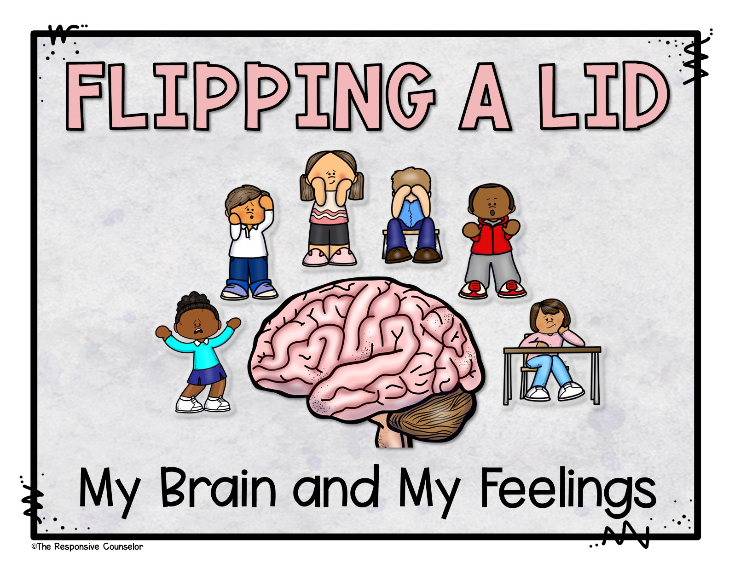
Notes:
Our brains are SO important. Today we’re going to learn some more about how our brains work.

Slide 2
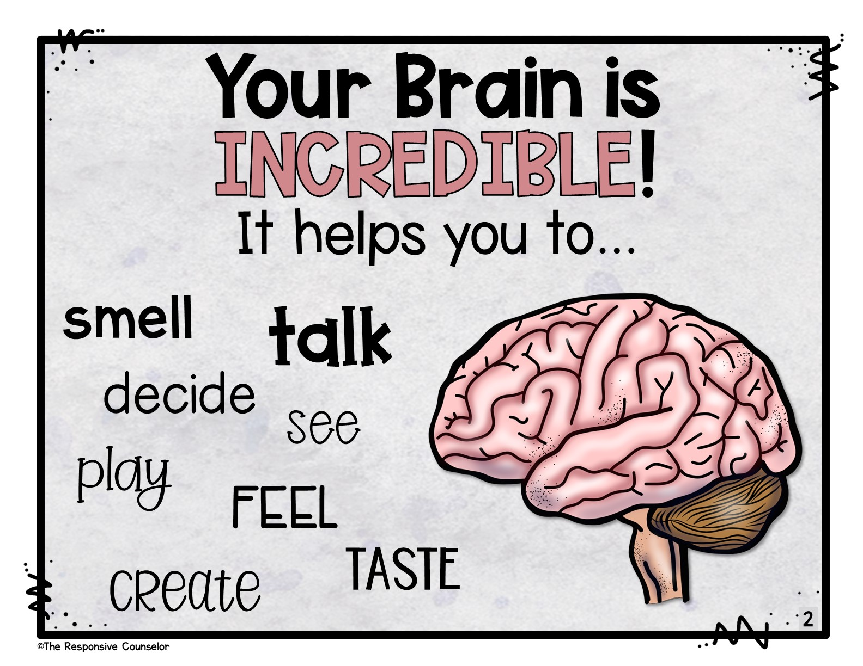
Notes:
Your brain is so incredible. It helps us to…talk, smell, decide, taste, run, create, feel, and see.

Slide 3
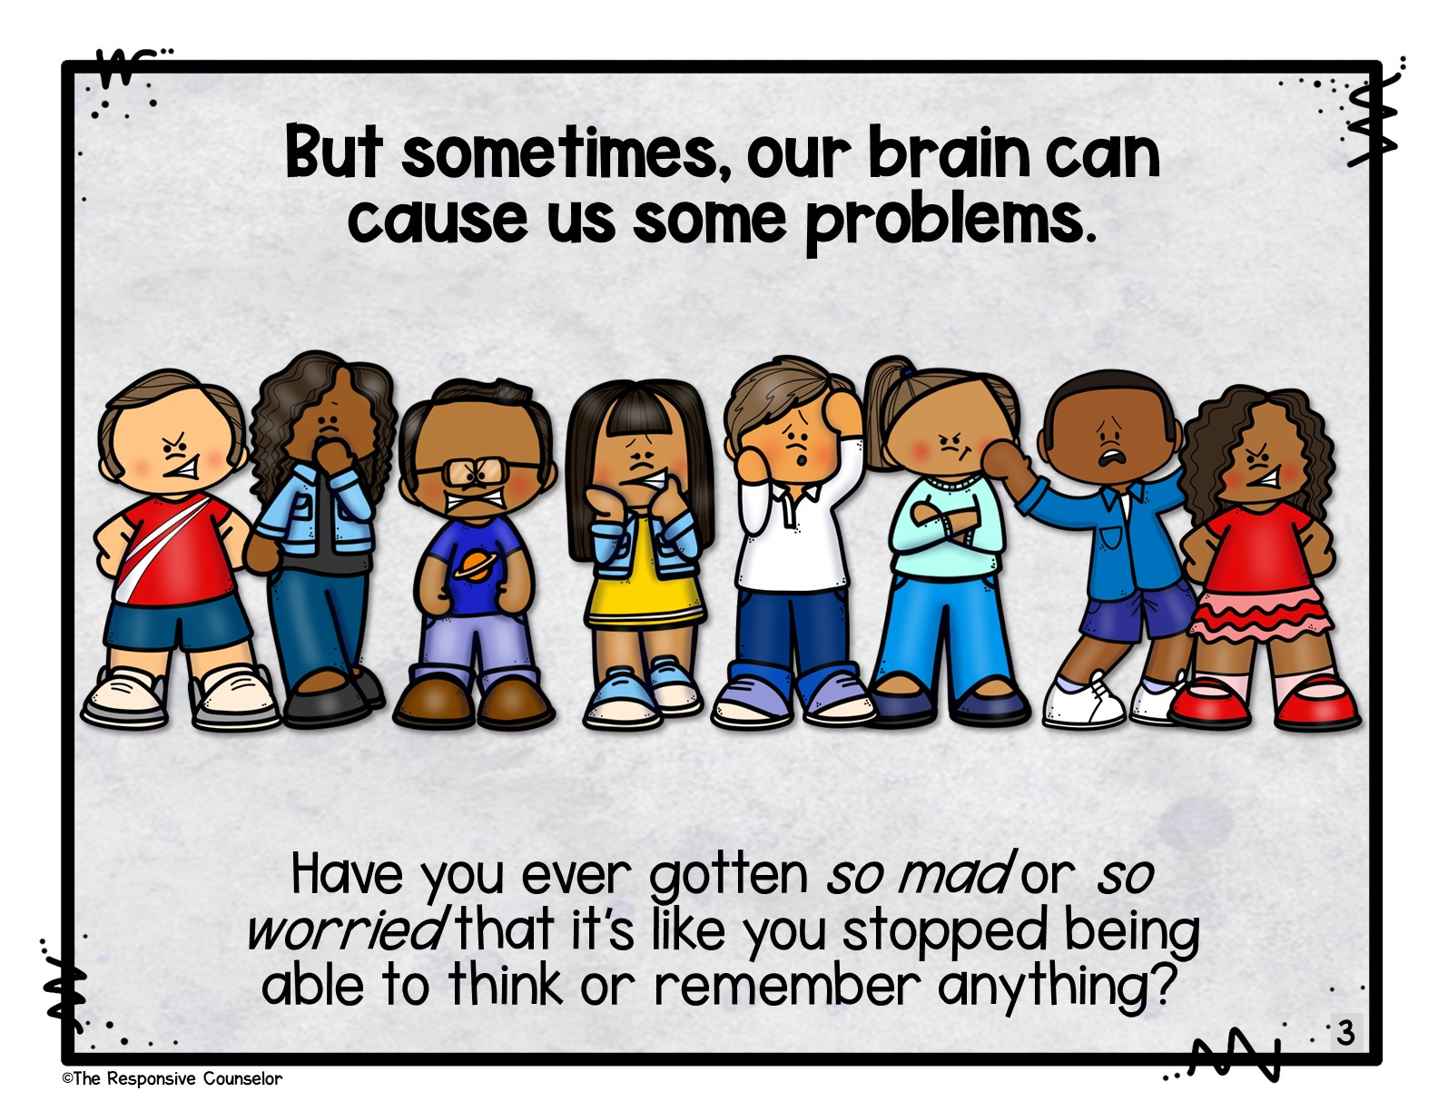
Notes:
But sometimes, our brain can cause us some problems. Have you ever gotten SO MAD or SO WORRIED that it’s like you stopped being able to think or remember anything?

Slide 4
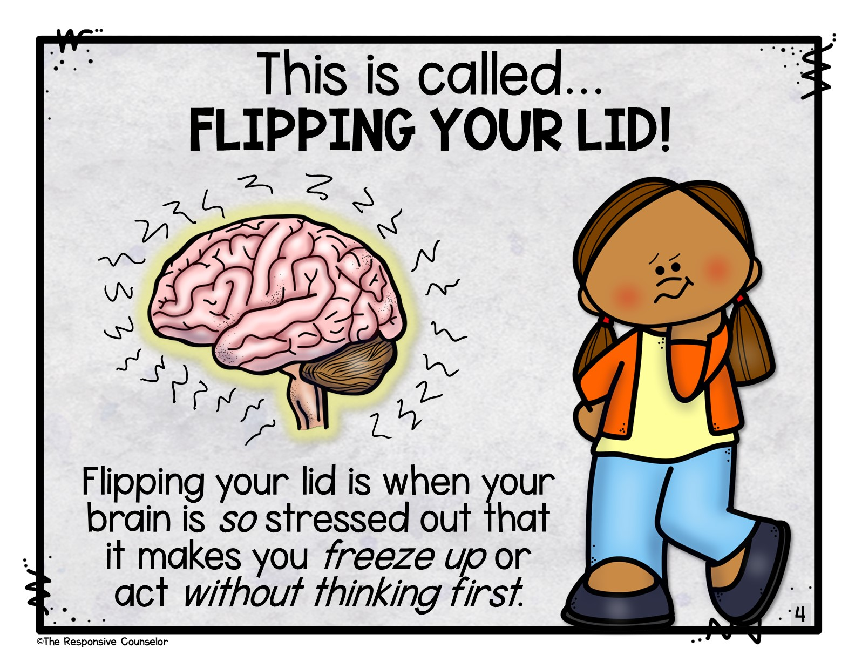
Notes:
This is called…Flipping Your Lid! Flipping your lid is when your brain is so stressed out that it makes you act without thinking first.

Slide 5
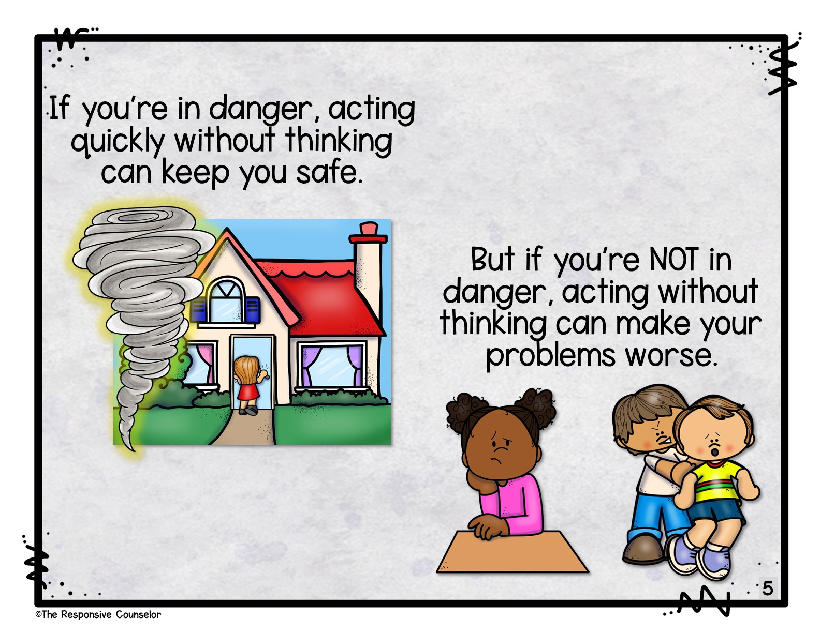
Notes:
If you’re in danger, acting quickly without thinking can keep you safe. But if you’re NOT in danger, acting without thinking can get you even more upset or in trouble.

Slide 6
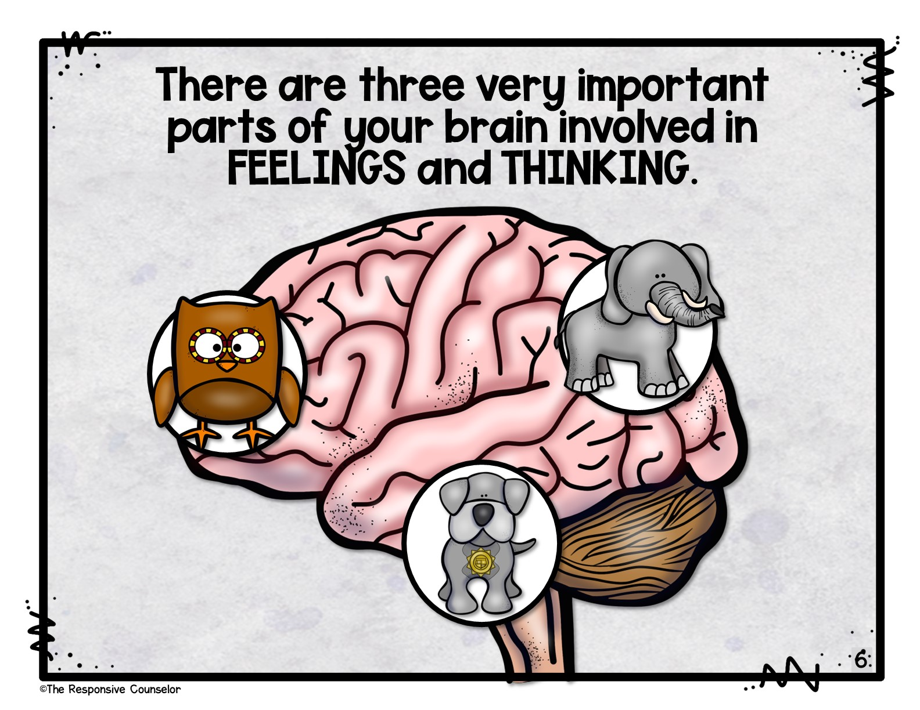
Notes:
There are three very important parts of your brain that we’re going to focus on.

Slide 7
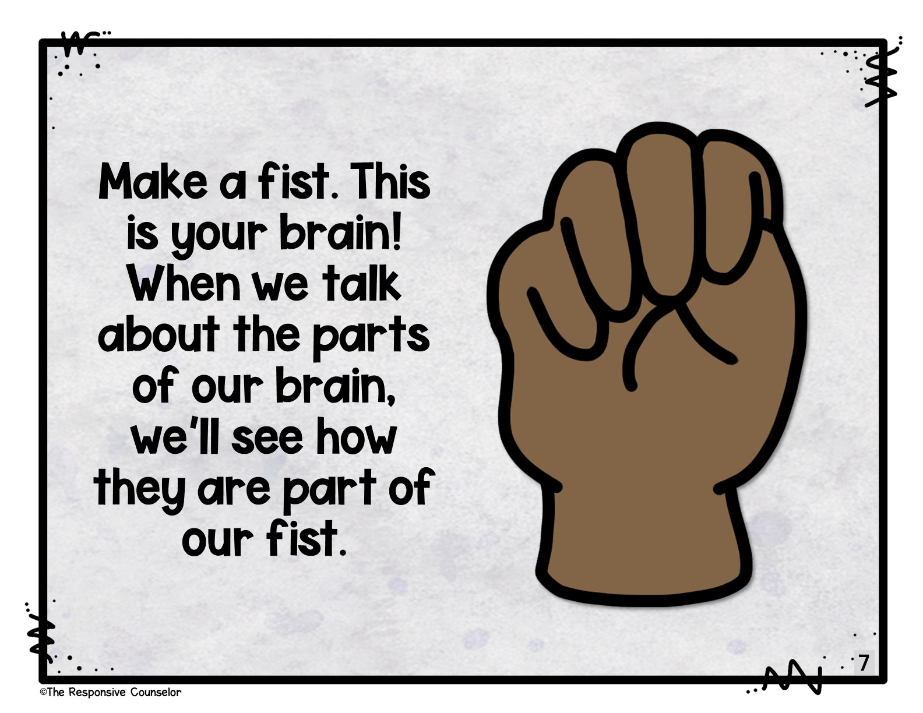
Notes:
Make a fist. This is your brain! When we talk about the parts of our brain, we’ll see how they are part of our fist.

Slide 8
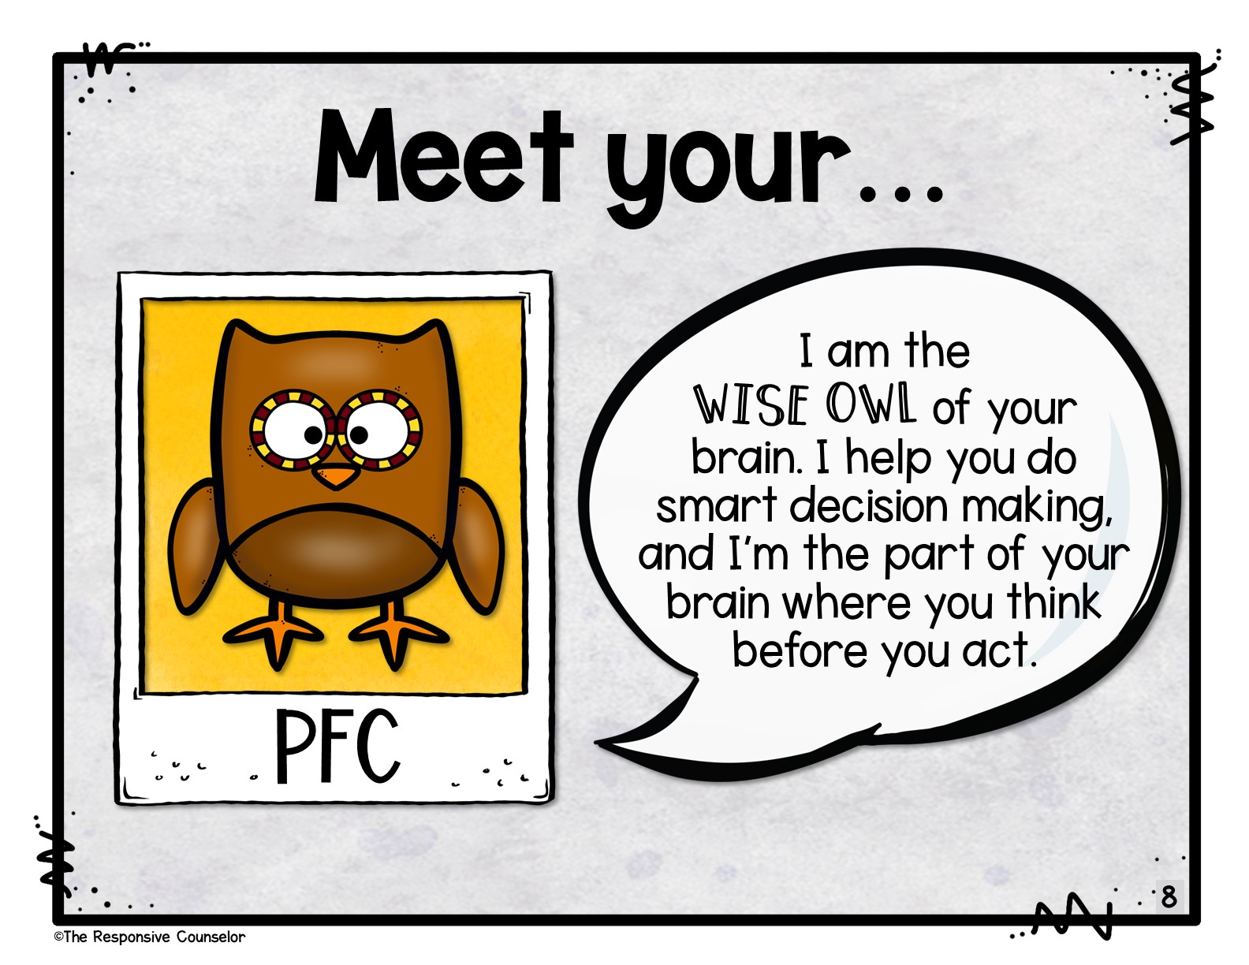
Notes:
Meet your…prefrontal cortex, your PFC! Can you say that? PFC. Your PFC is the wise owl of your brain. It’s the part of your brain that makes smart decisions and helps you to think before you act (or speak).

Slide 9
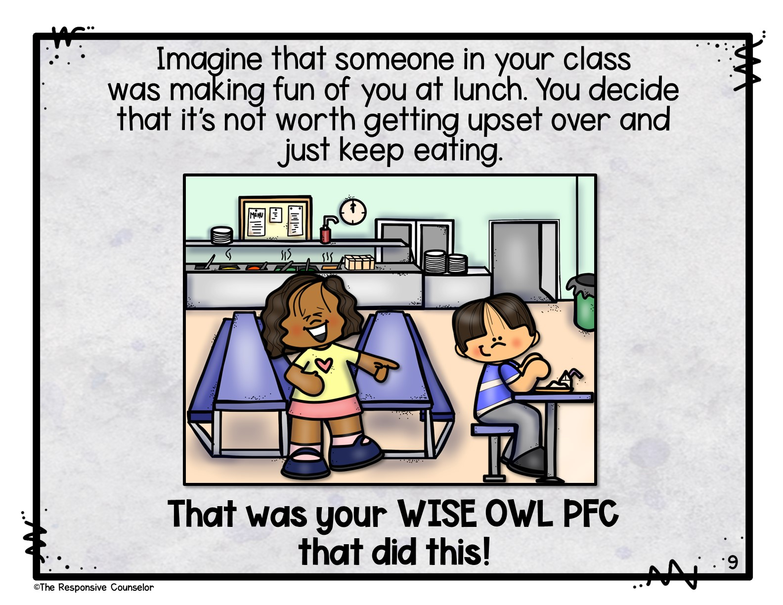
Notes:
Someone in your class was making fun of you at lunch. You decide that it’s not worth getting upset over and just keep eating. This was your wise owl PFC that did this!

Slide 10
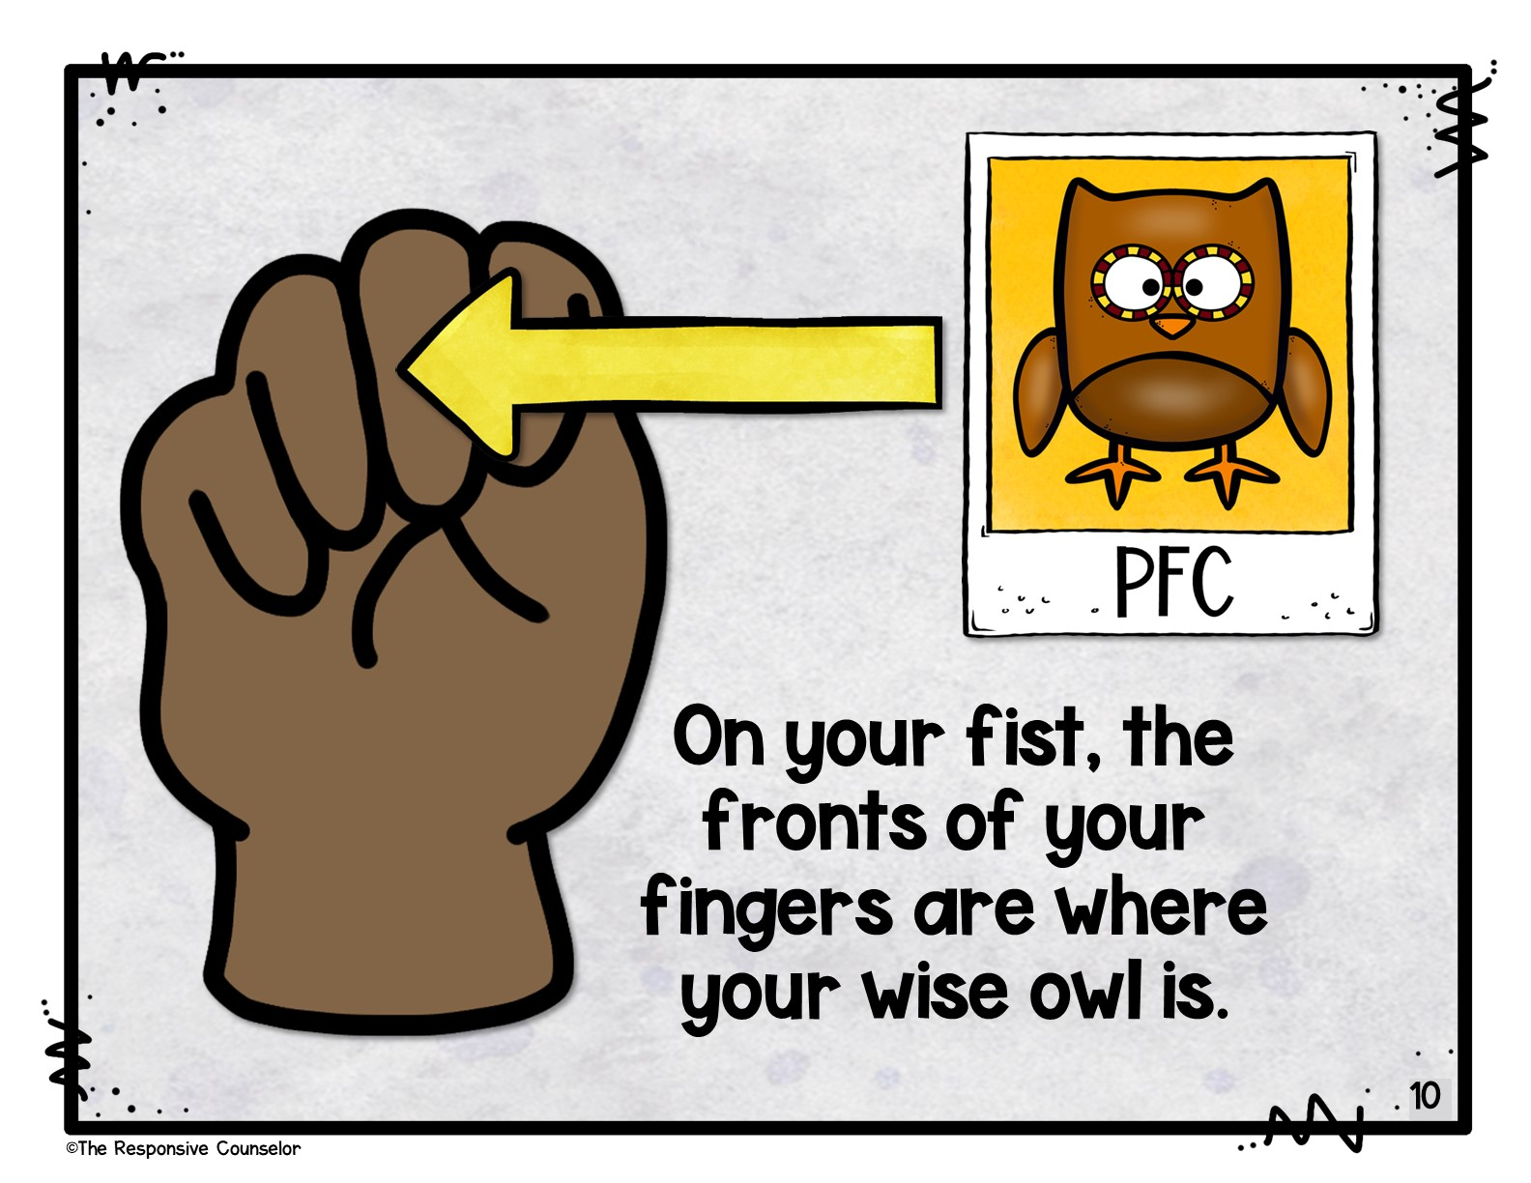
Notes:
Look at your fist brain. The fronts of your fingers are where your wise owl is.

Slide 11
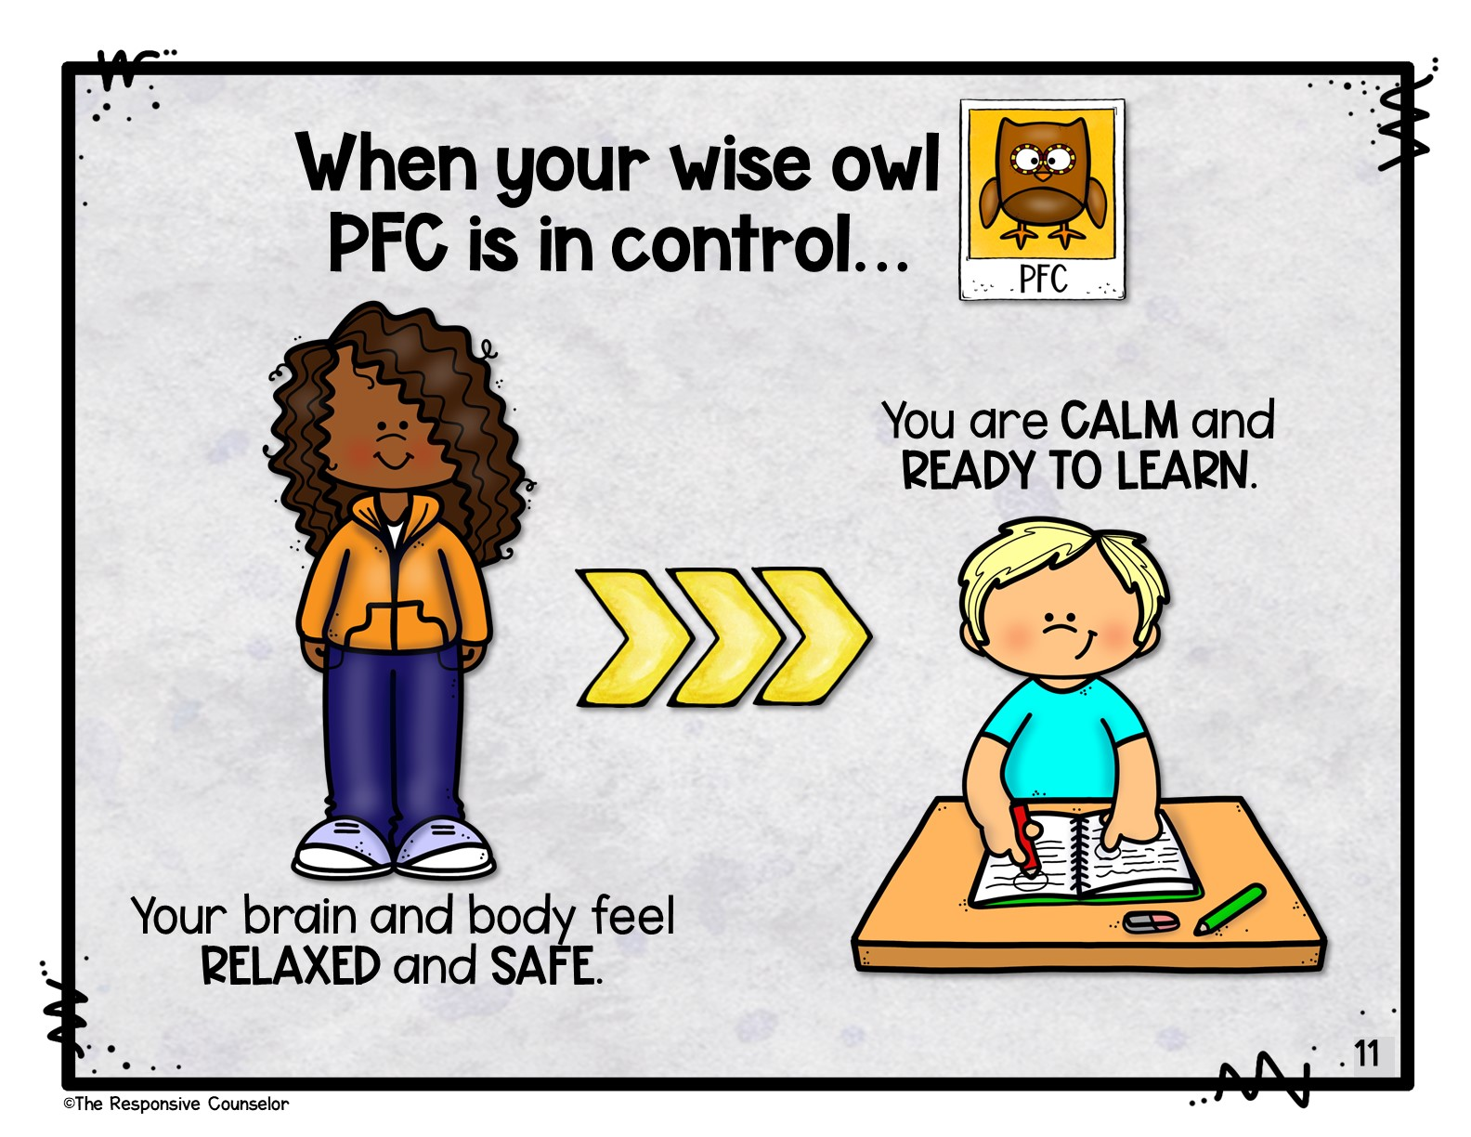
Notes:
When your wise owl PFC is in control…your brain and body feel relaxed and safe. You are calm and ready to learn.

Slide 12
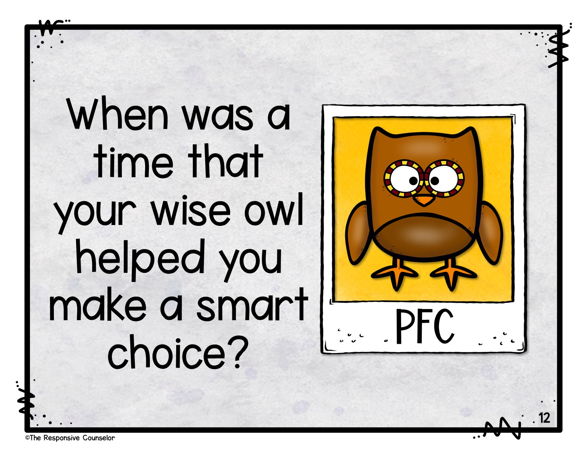
Notes:
Think about a time your wise owl PFC helped you make a smart choice. Turn and talk with a partner and tell them.

Slide 13
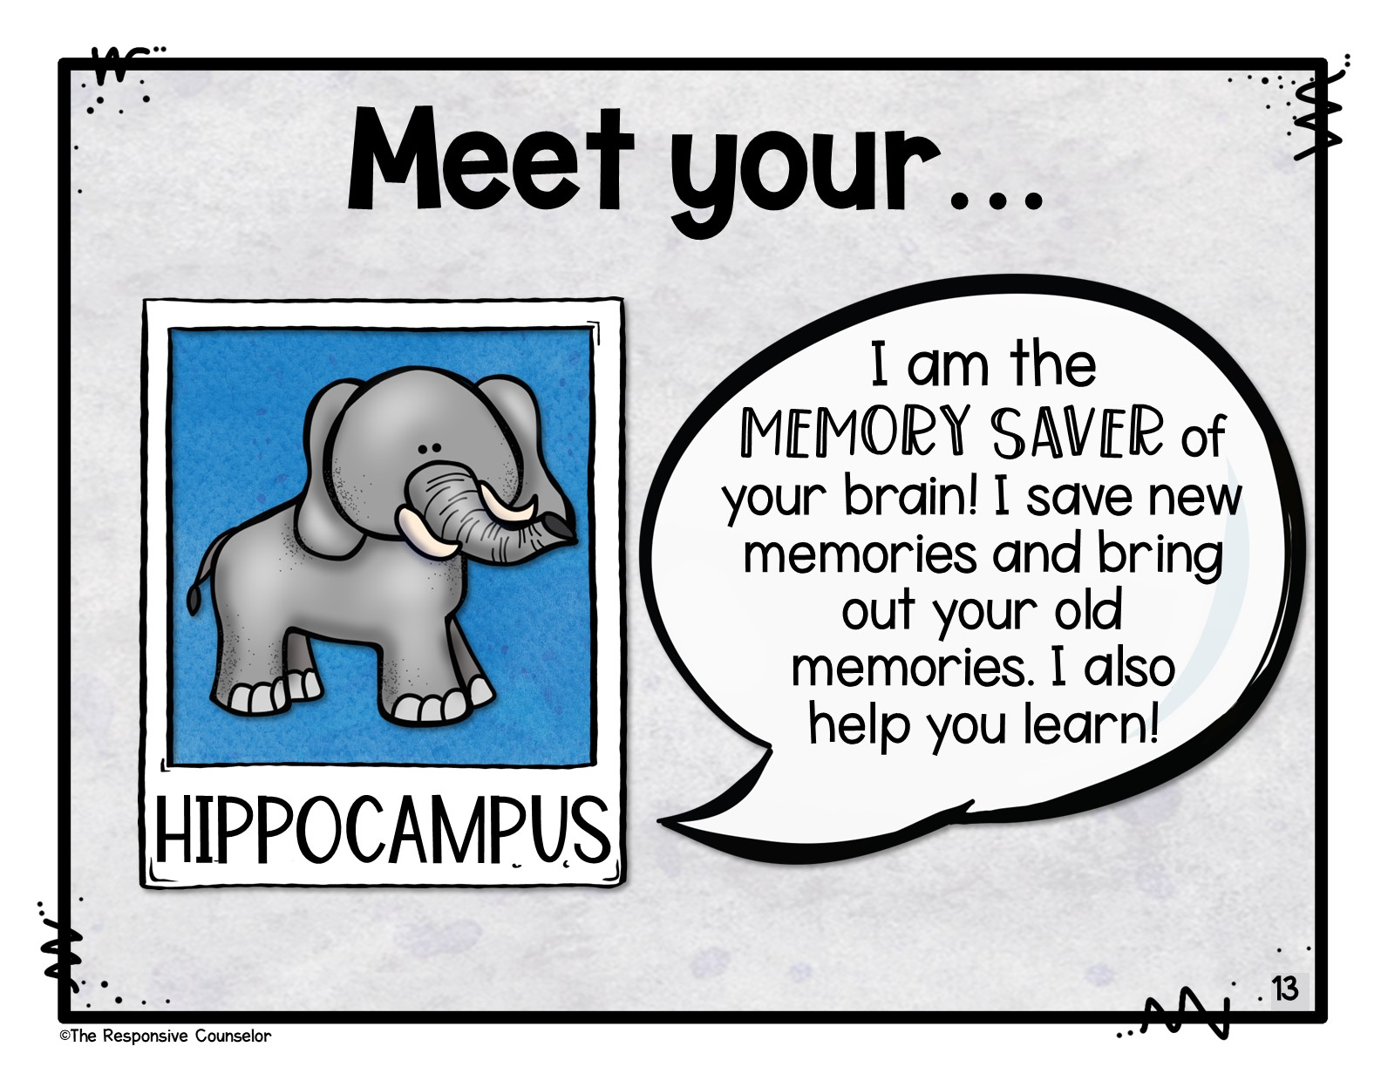
Notes:
Meet your…hippocampus! Can you say that? Hippocampus. The other name for this is the “memory saver” in your brain. It saves new memories…brings up old memories…and helps you learn.

Slide 14
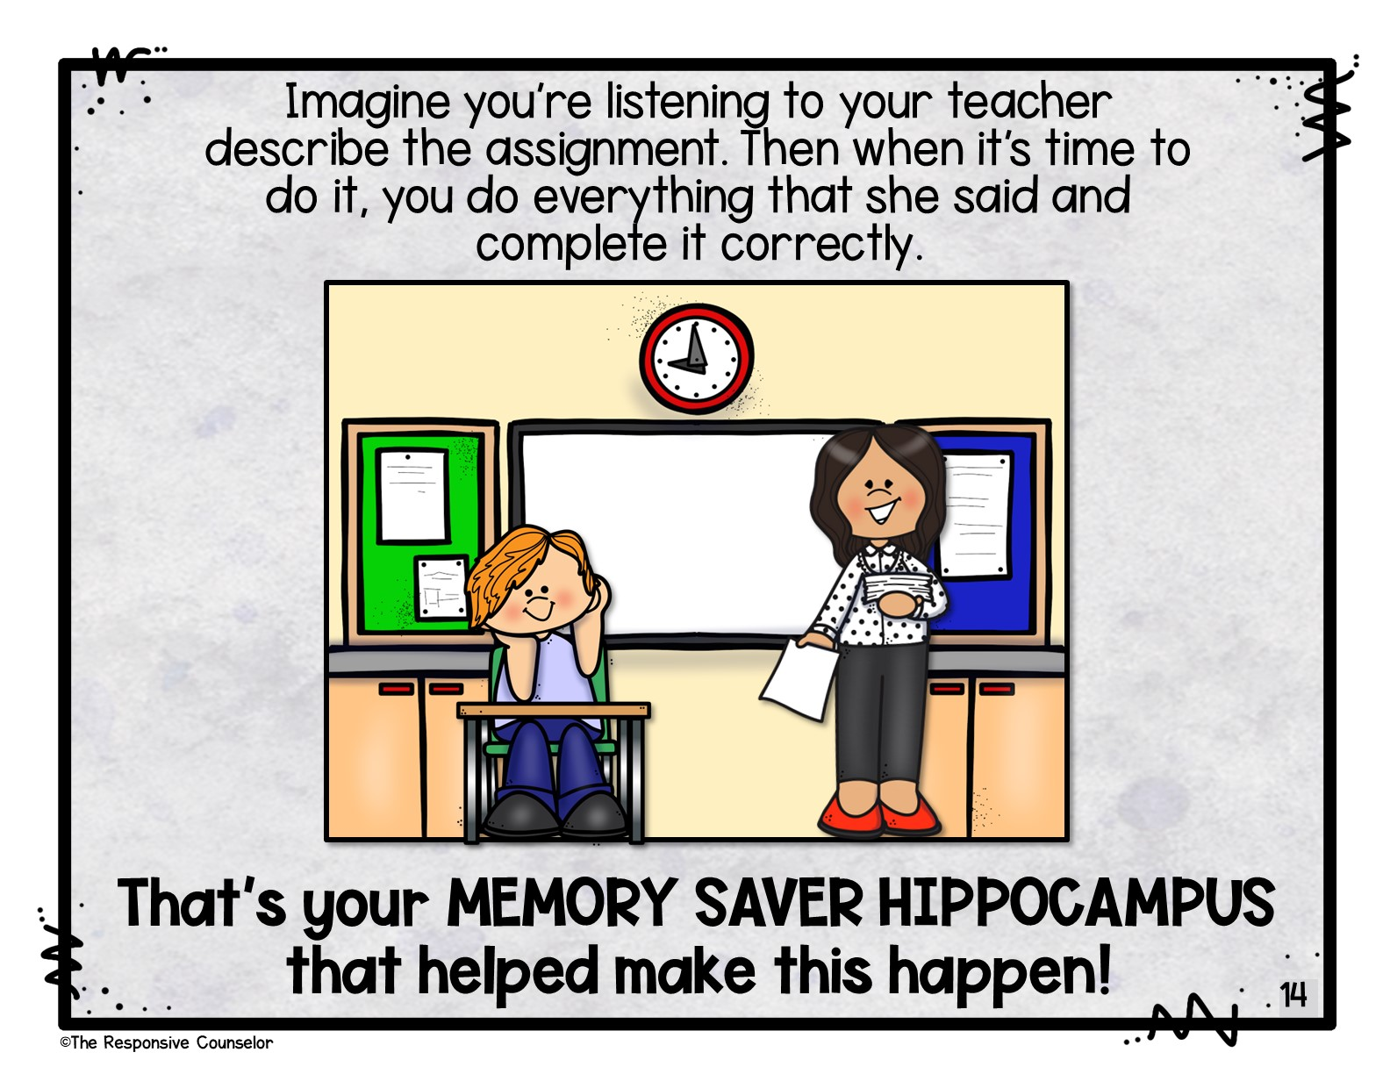
Notes:
You’re sitting in class, listening to your teacher describe your assignment. Then when it was time to do it, you got right to work and completed it correctly. That’s your memory saver hippocampus that helped make this happen!

Slide 15
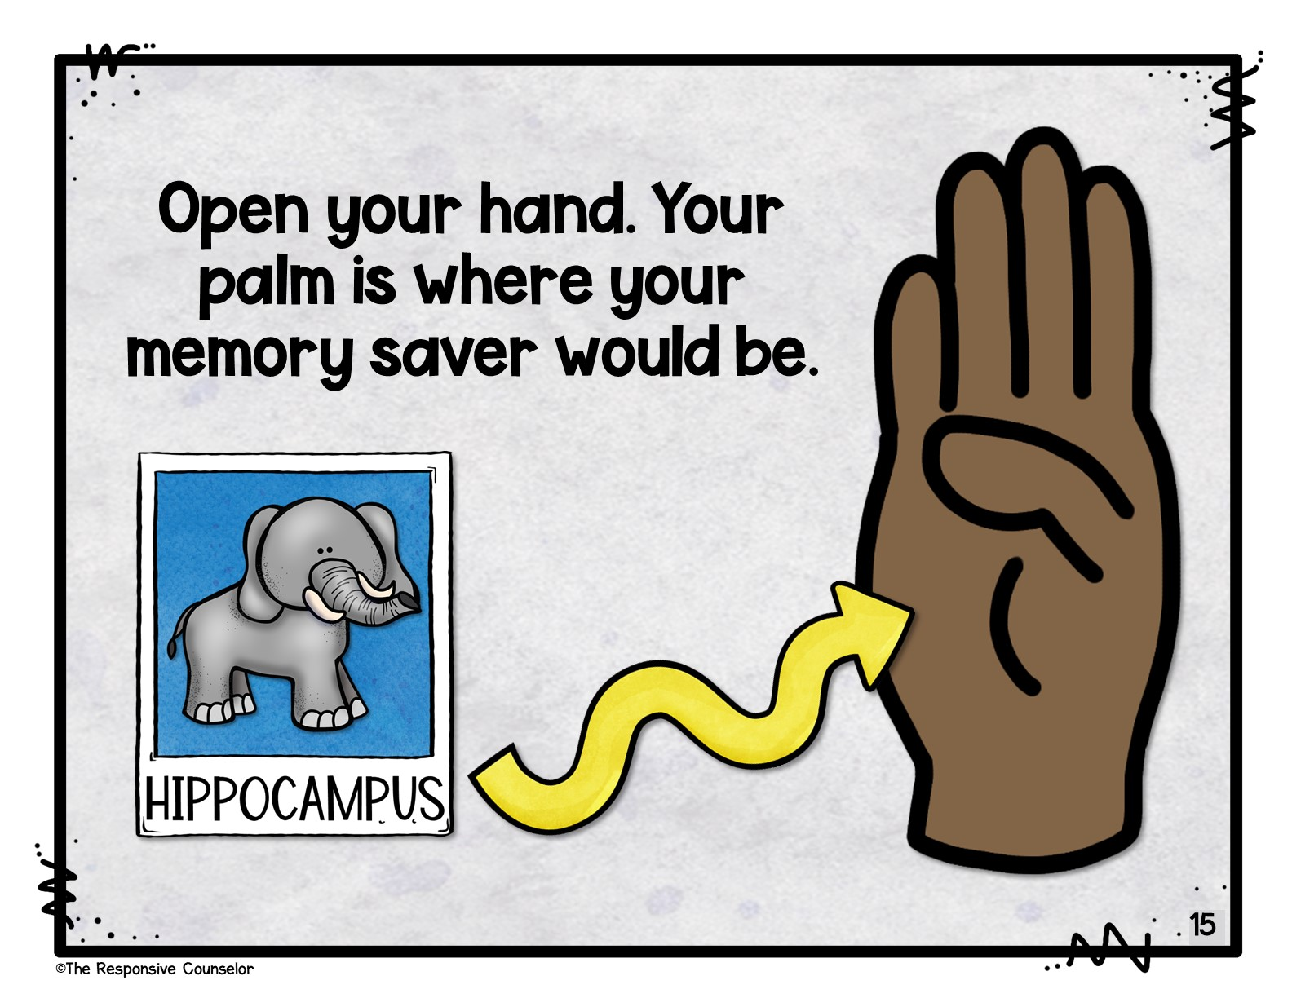
Notes:
If you open up your first brain and take a look at your palm, that’s where your memory saver hippocampus would be.

Slide 16
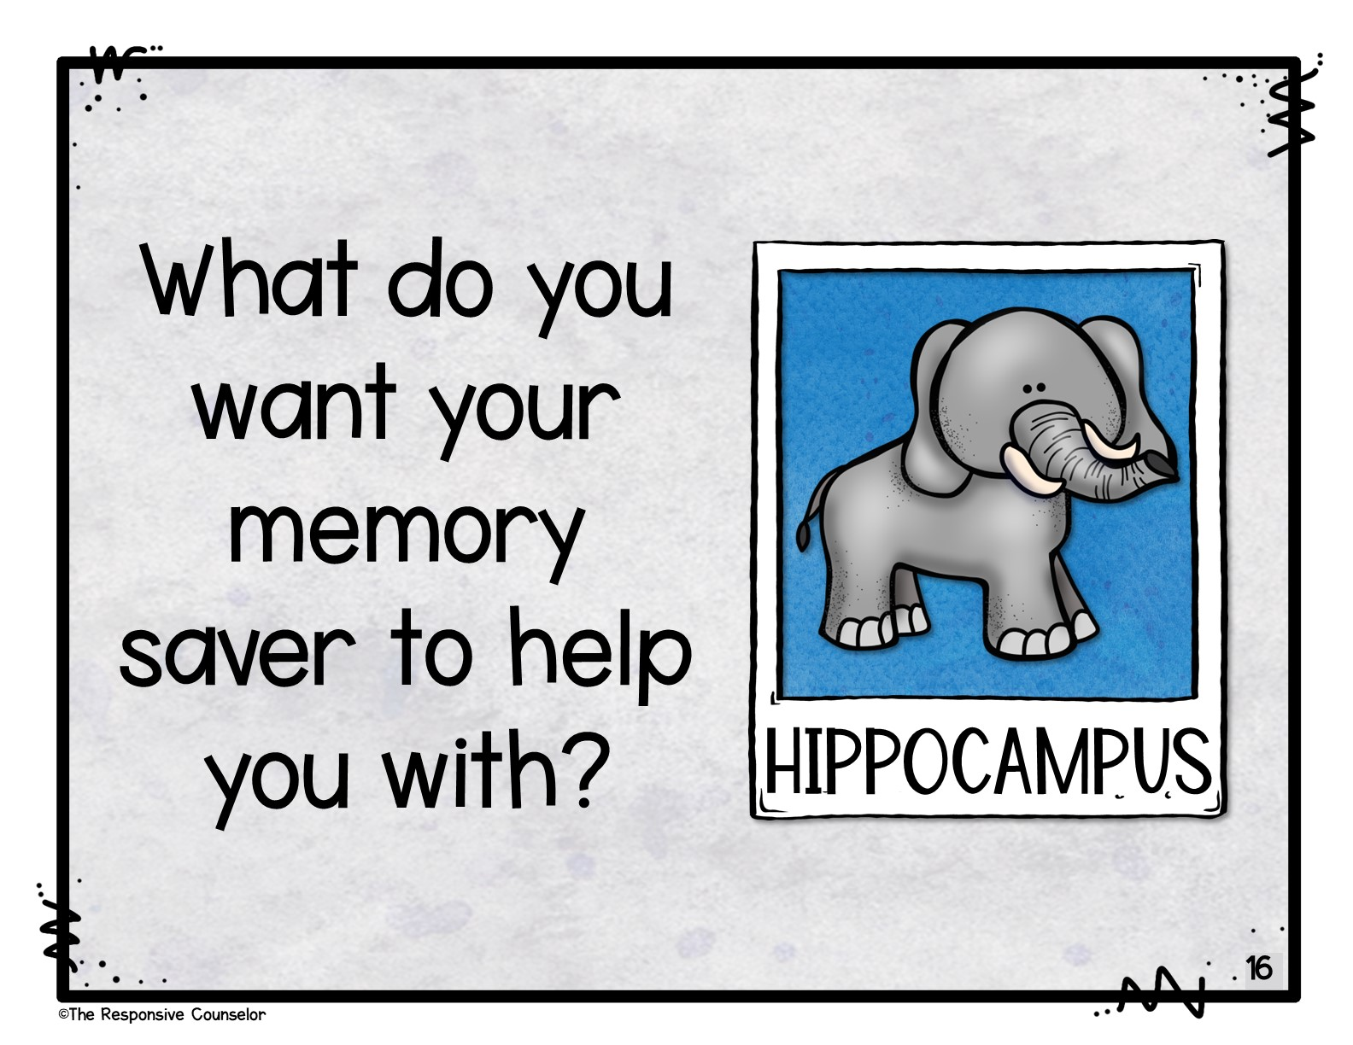
Notes:
Think about something that’s important for you to remember. What do you want your hippocampus to help you with? Turn and talk with a partner and tell them.

Slide 17
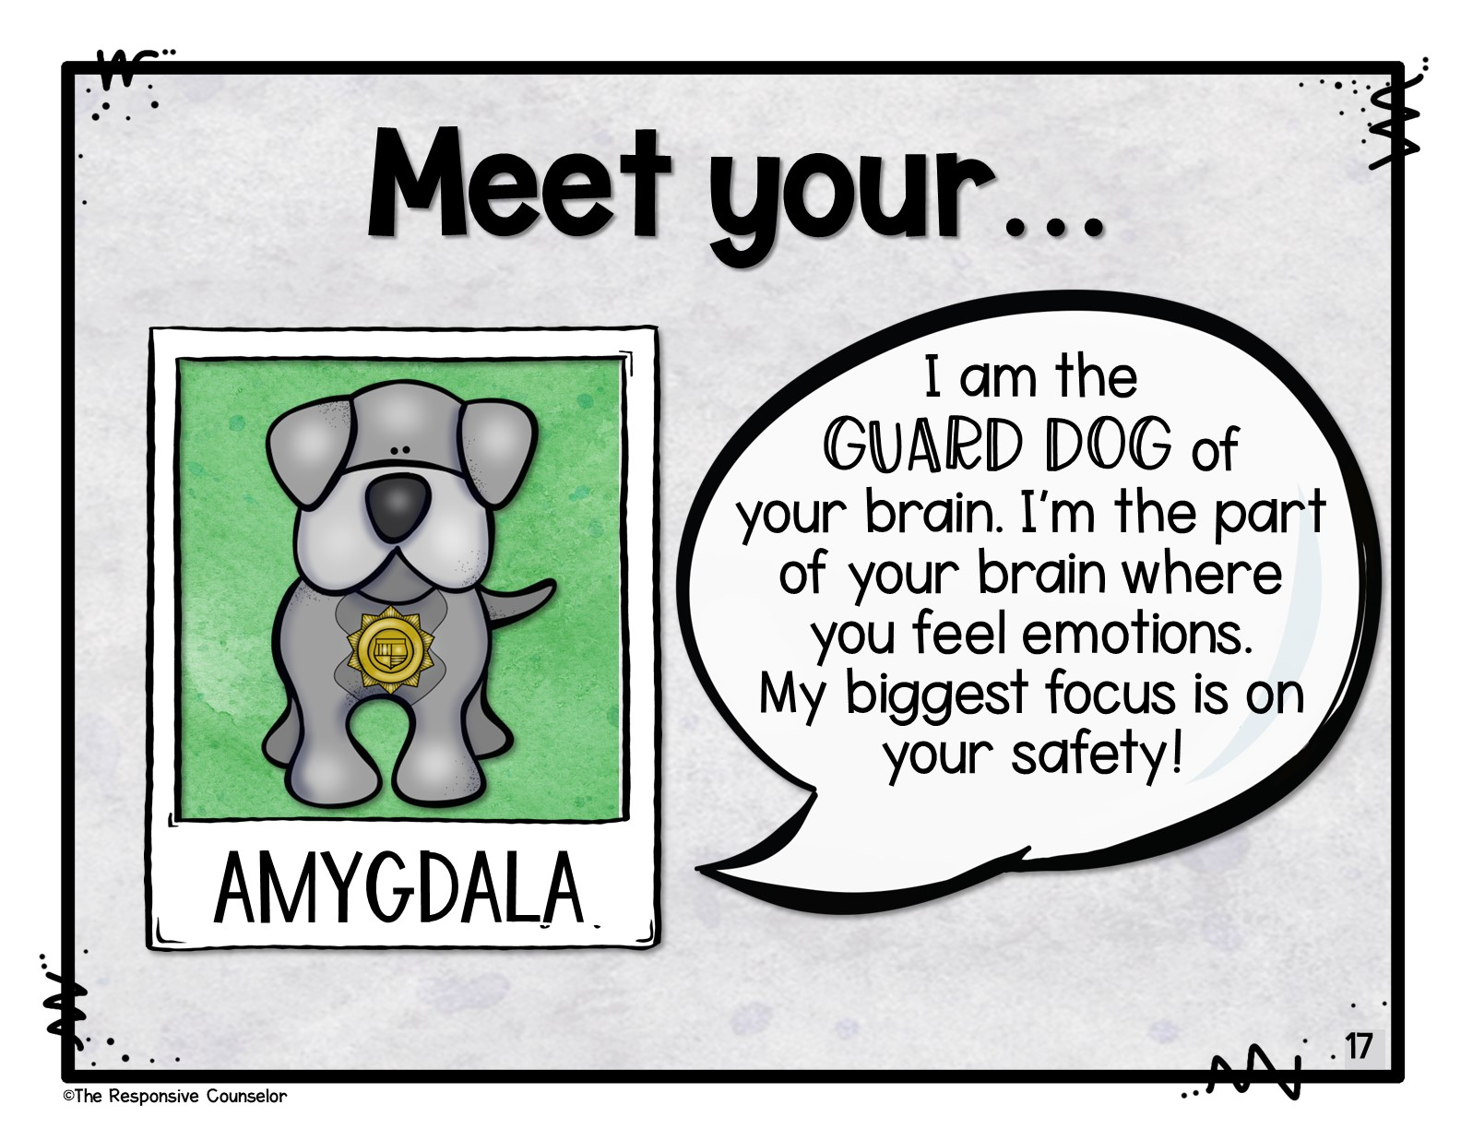
Notes:
Meet your…amygdala! Can you say that? Amygdala. The amygdala is the guard dog of your brain. It is where you feel your feelings and it is super focused on keeping you safe.

Slide 18
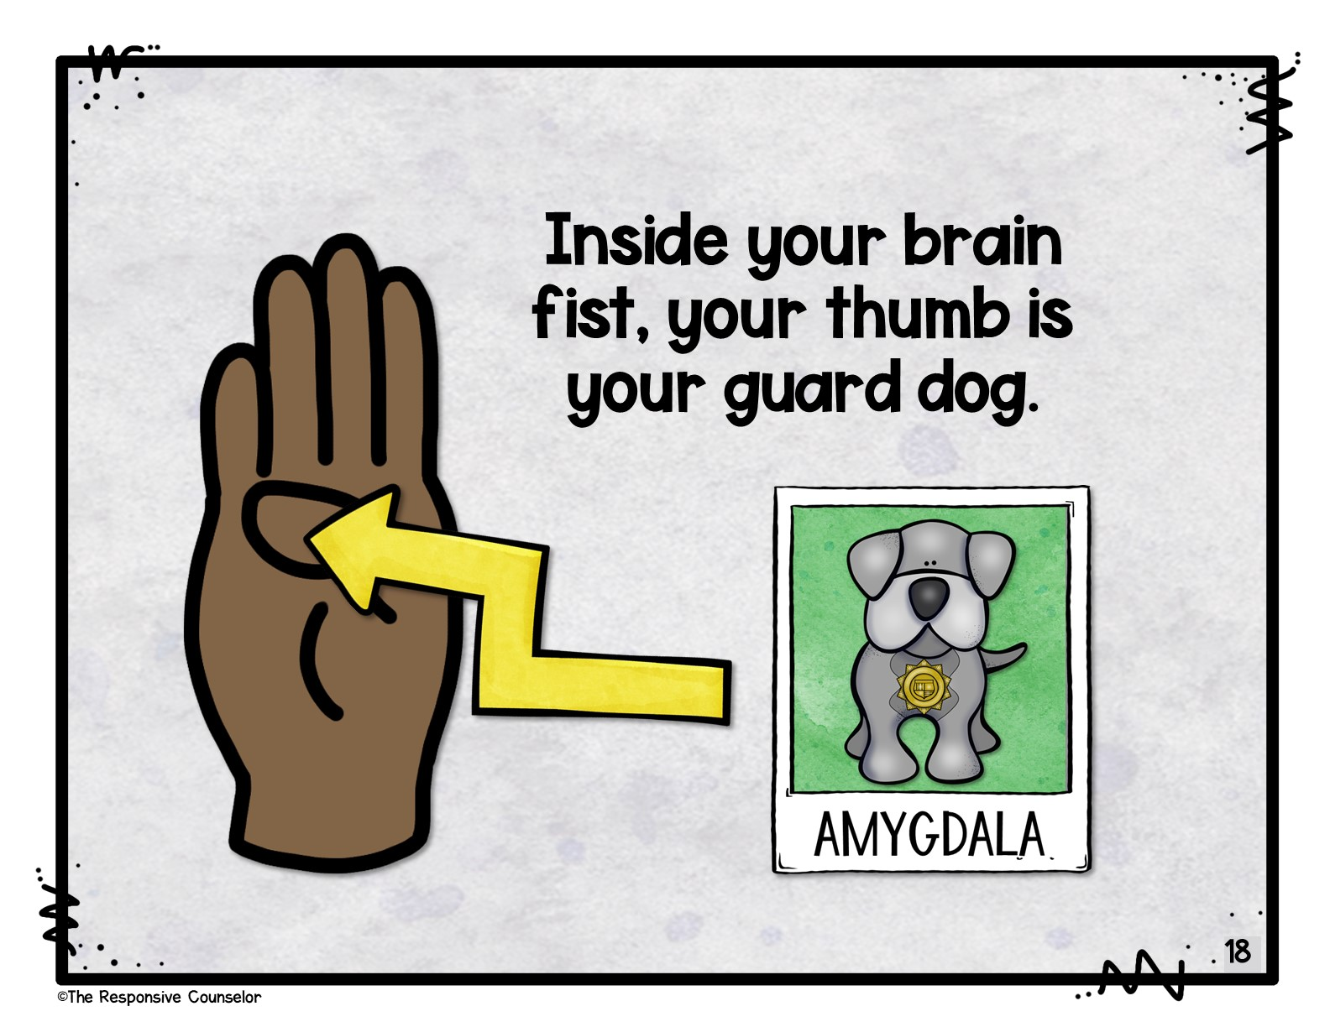
Notes:
Inside your brain fist, your thumb is your guard dog amygdala.

Slide 19
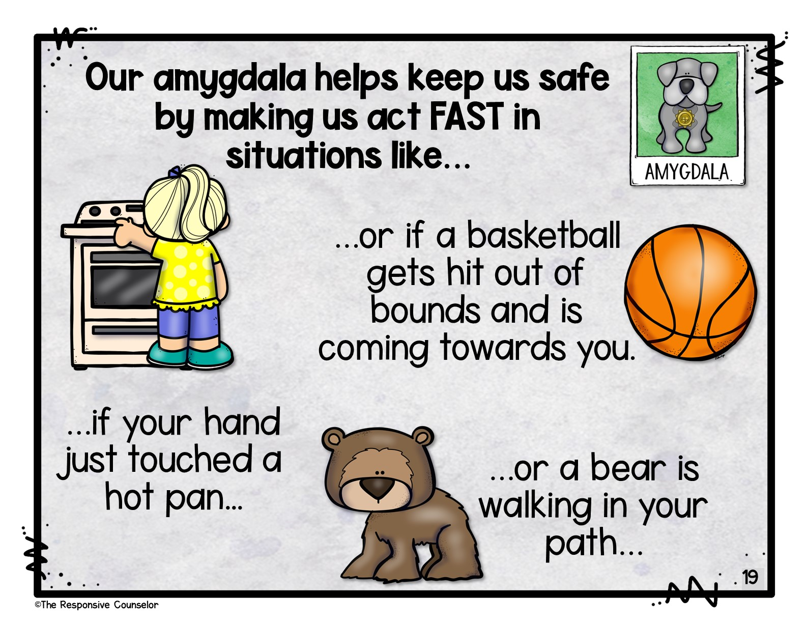
Notes:
Our amygdala helps keep us safe by making us act fast in situations like…if your hand just touched a hot pan…or a bear is walking in your path…or if a basketball gets hit out of bounds and is coming towards you.

Slide 20
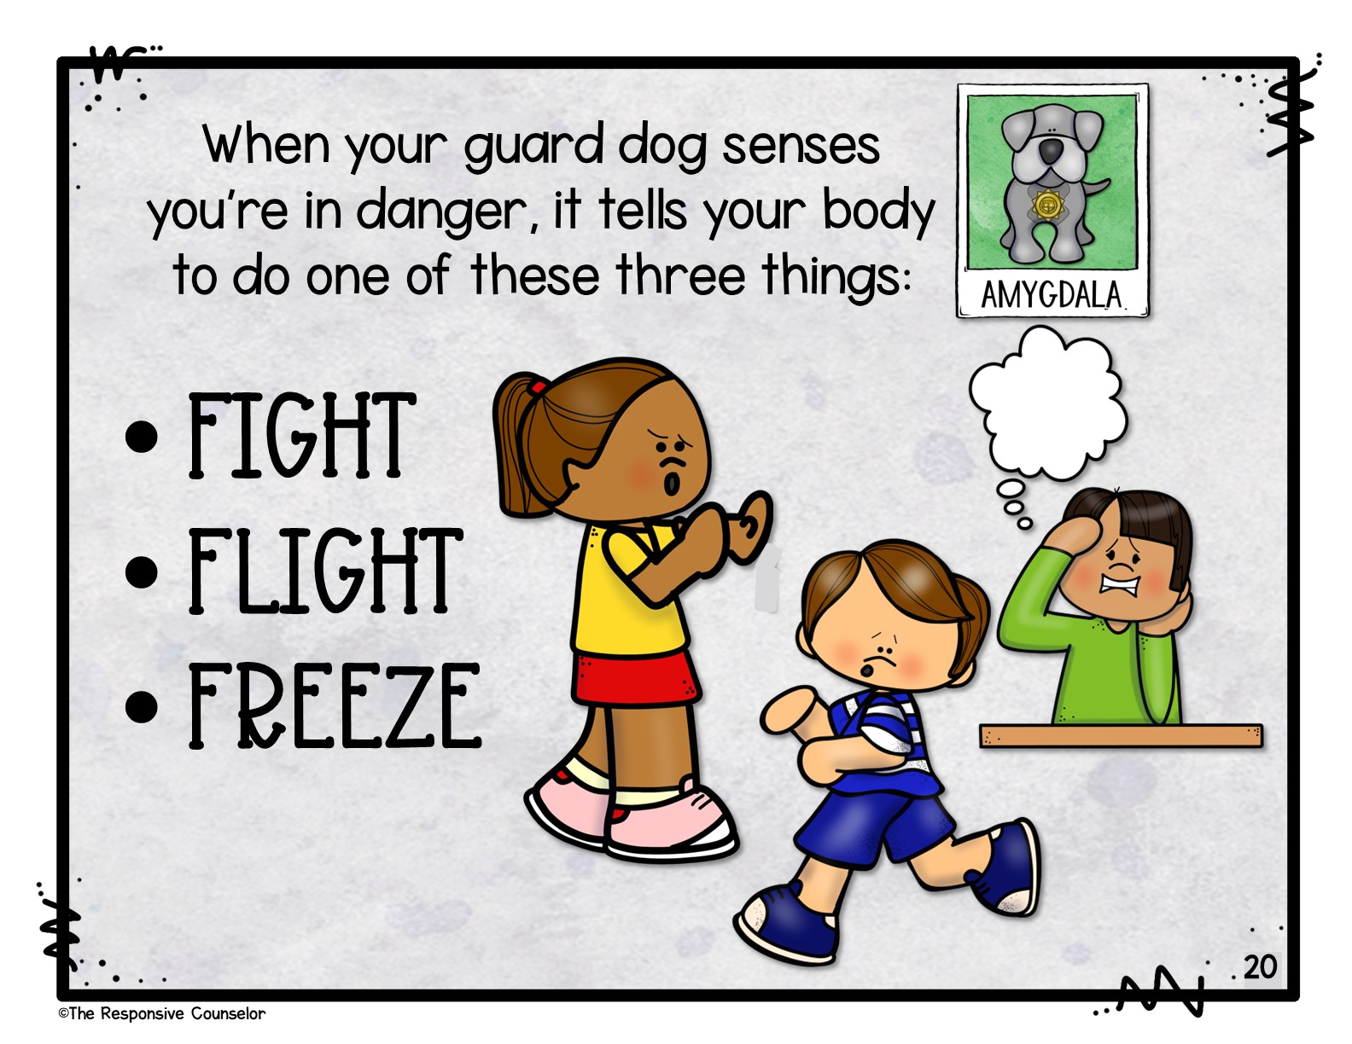
Notes:
When your guard dog senses you’re in danger, it tells your body to do one of these three things: fight, flight, or freeze.

Slide 21
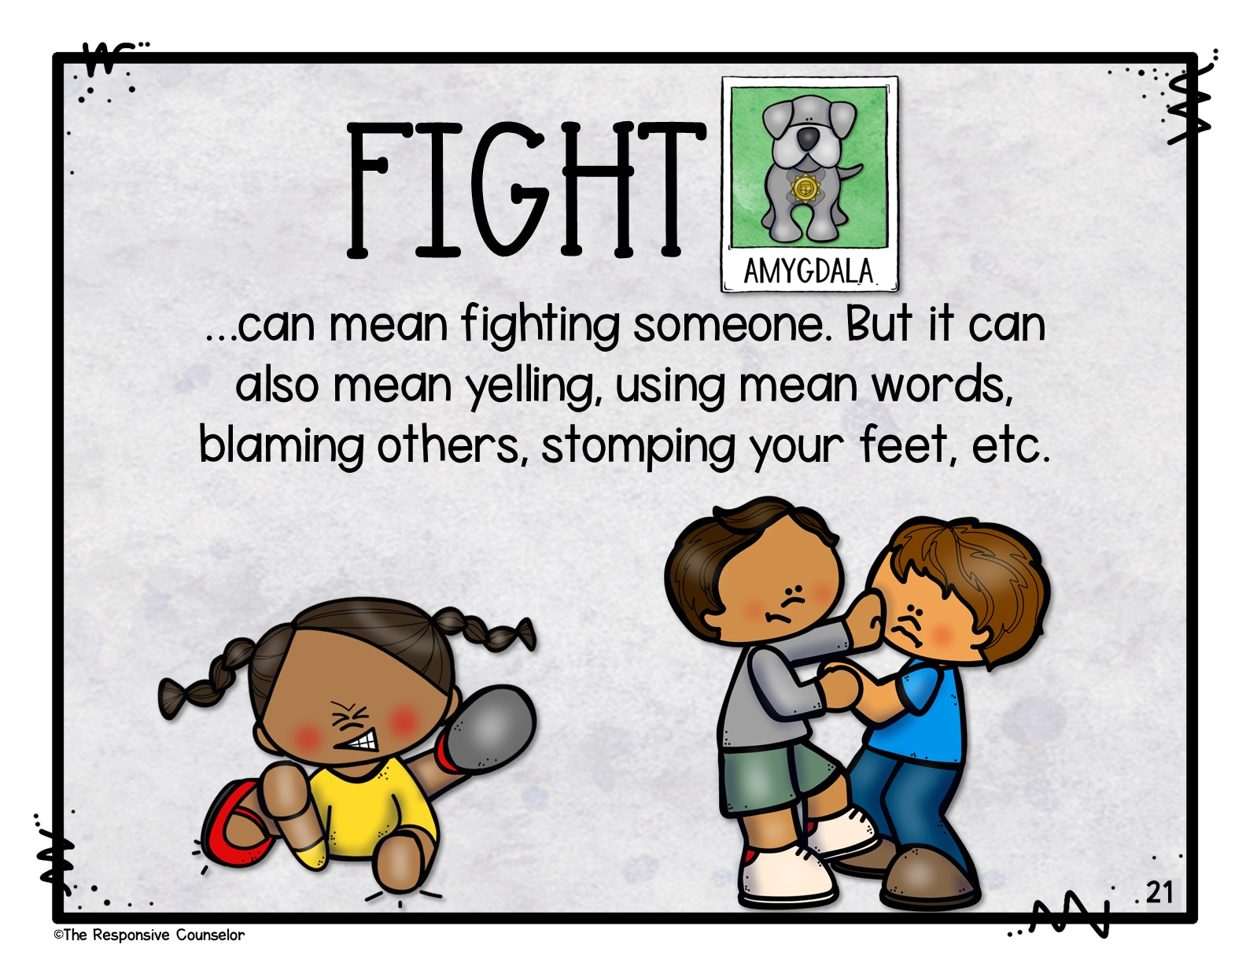
Notes:
When your amygdala, your guard dog, tells your body to “fight” to keep you safe…that can mean fighting someone. But it can also mean yelling, using mean words, blaming others, stomping your feet, etc.

Slide 22
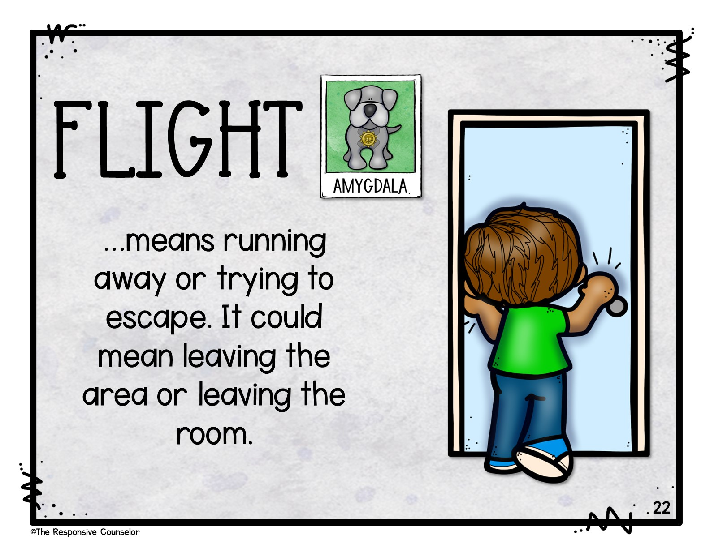
Notes:
And when “flight” is the option your guard dog picks, that could mean running away or trying to escape. Like leaving the area or leaving the room.

Slide 23
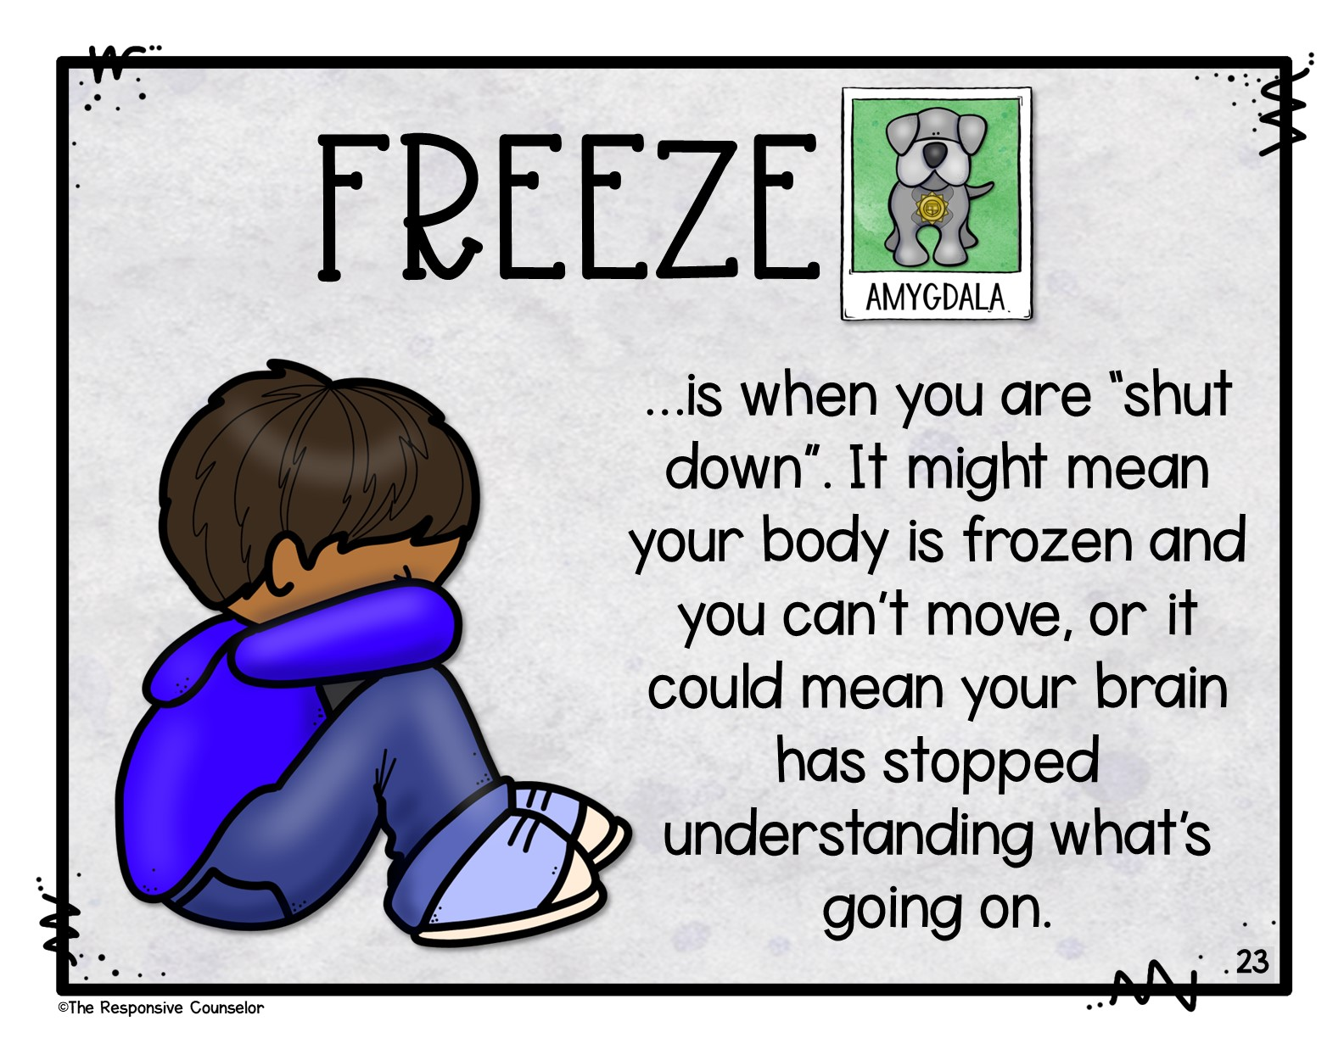
Notes:
If your guard dog amygdala thinks you’re in danger and tells you to freeze, it’s like when you are “shut down”. It might mean your body is frozen and you can’t move, or it could mean your brain has stopped understanding what’s going on.

Slide 24
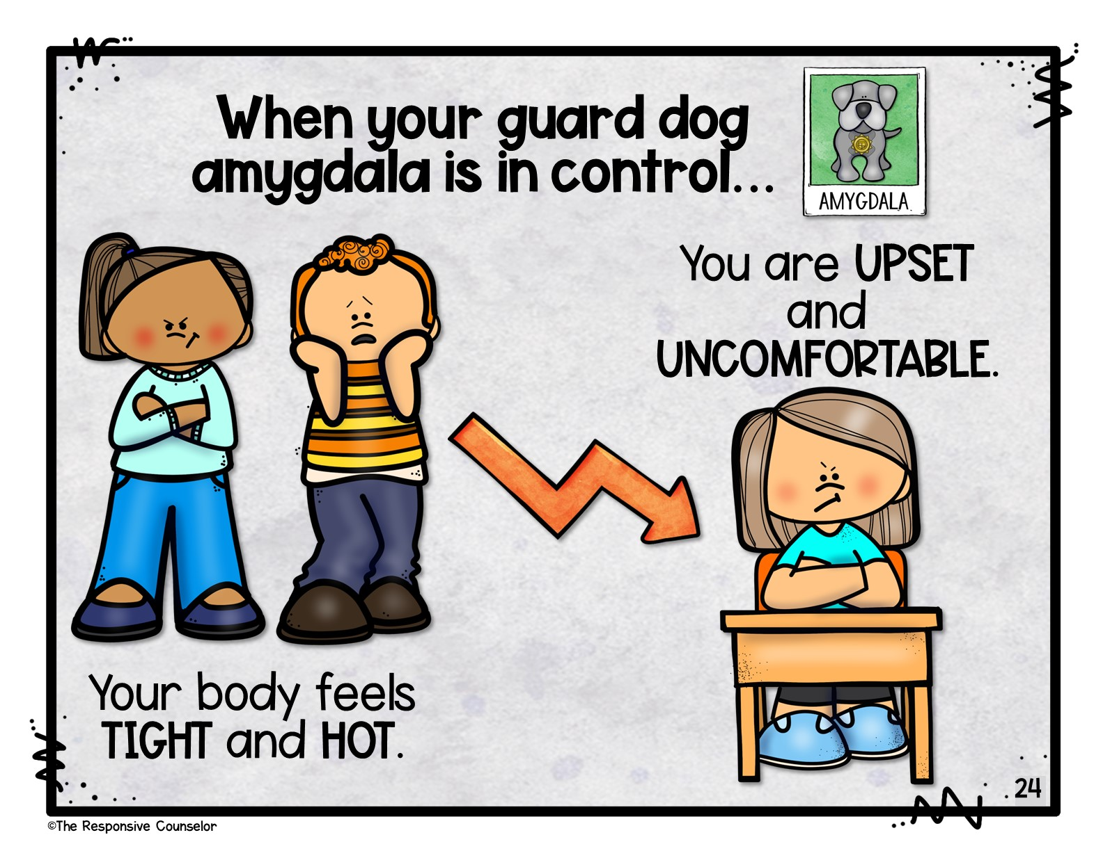
Notes:
When your guard dog amygdala is in control…your body feels tight and hot. You are upset and uncomfortable. What are some things you might notice about how your body feels when your guard dog is in control? When you’re angry or scared, what do you feel in your body?

Slide 25
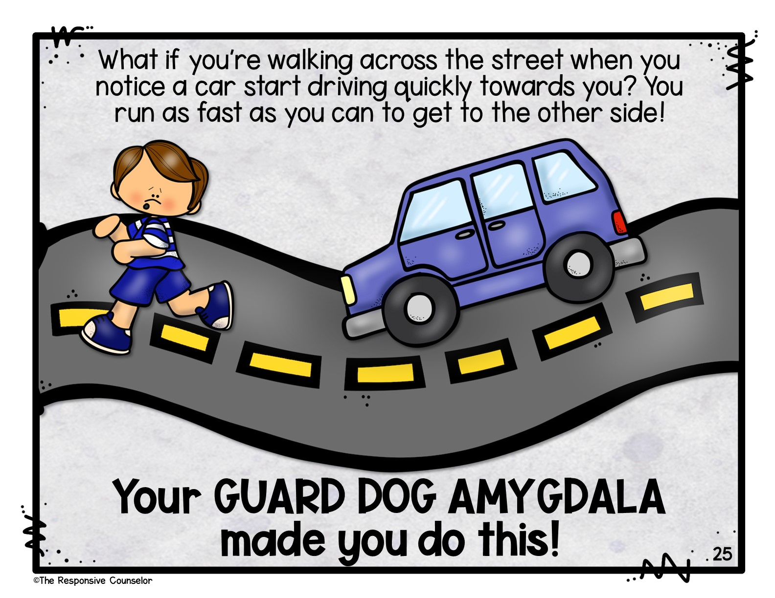
Notes:
What if you’re walking across the street when you notice a car start driving quickly towards you. You run as fast as you can to get to the other side. Your guard dog amygdala made you do this.

Slide 26
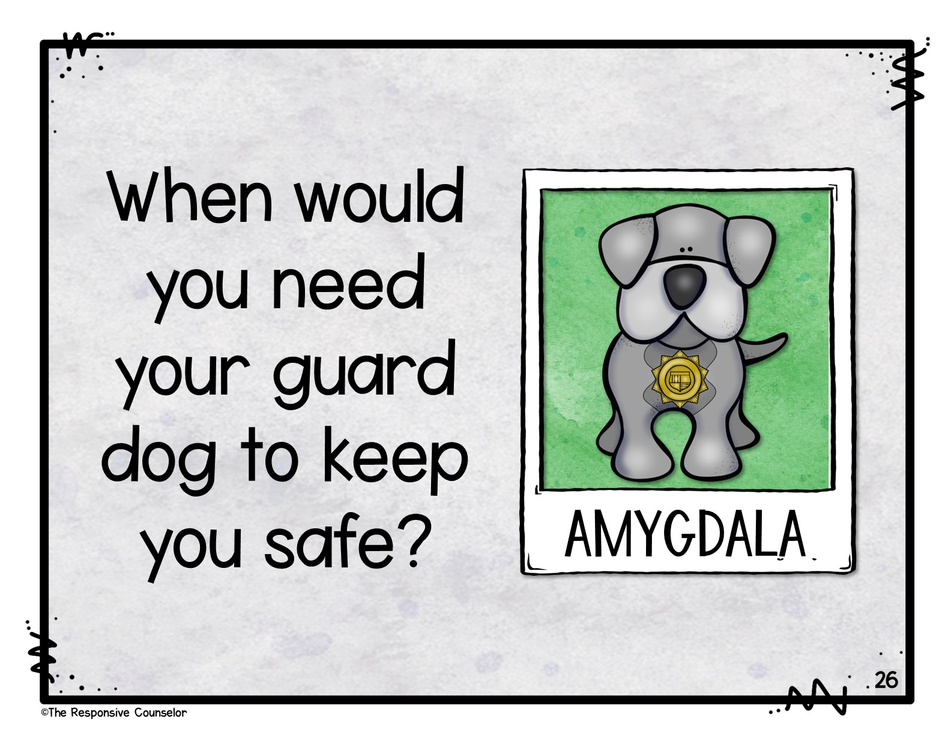
Notes:
When is another situation that you need your guard dog to keep you safe? When else do you need to act quickly without thinking to avoid danger? Turn and talk with a partner. (If you are breaking this lesson into sections, now is where you may want to stop)

Slide 27
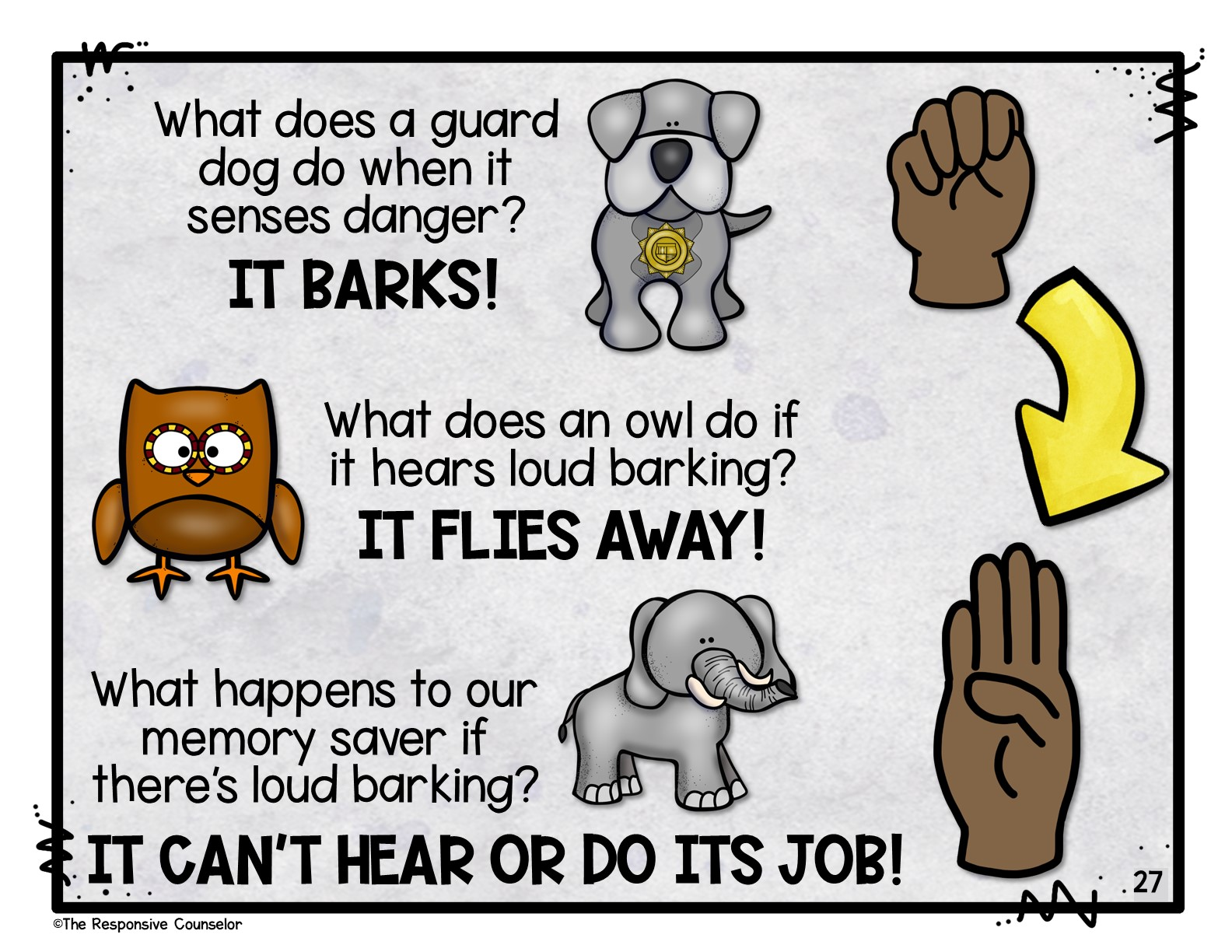
Notes:
What does a guard dog do when it sense danger? It barks! Make your thumb bark inside your fist. Ok now what does an owl do if it hears loud barking. It flies away! Make your wise owl PFC fly away. What do you think happens to our memory saver if there’s loud barking? It can’t hear or do it’s job!

Slide 28
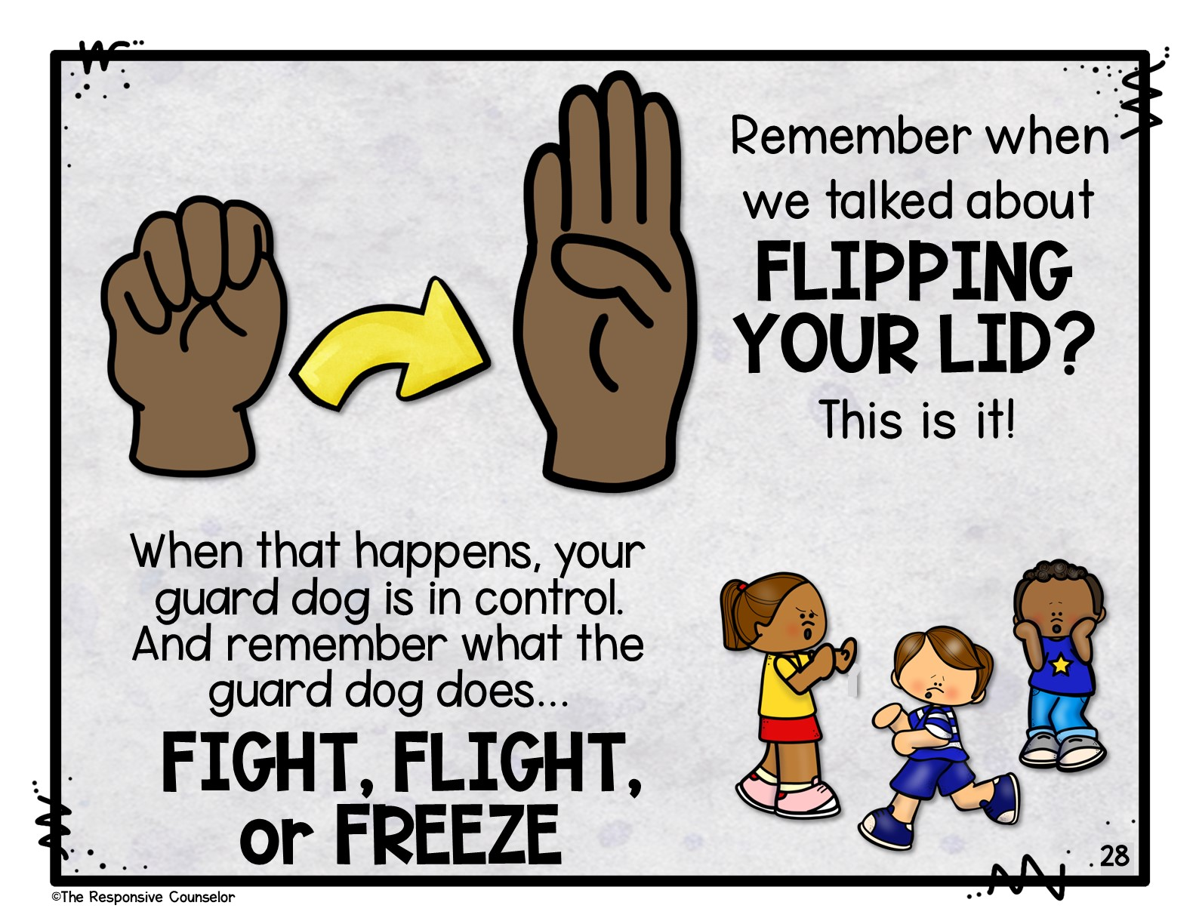
Notes:
Remember when we talked about flipping your lid? This is it! Make a brain fist…now flip up the wise owl PFC. That’s your brain flipping it’s lid. When that happens, your guard dog is in control. And remember what the guard dog does…FIGHT, FLIGHT, or FREEZE!

Slide 29
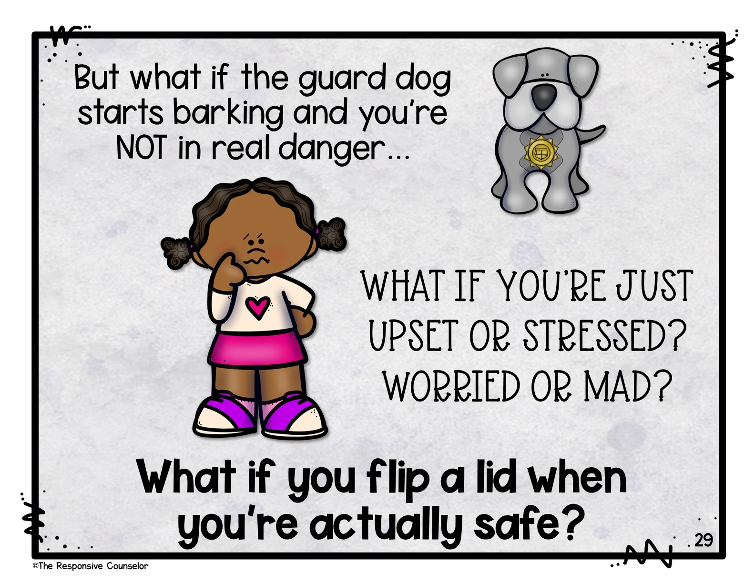
Notes:
But what if the guard dog starts barking and you’re NOT in real danger…what if you’re just upset or stressed? Worried or mad? What if you flip a lid when you’re actually safe? (If you’re doing the act aloud skits, this would be a great time to do the first one!)

Slide 30
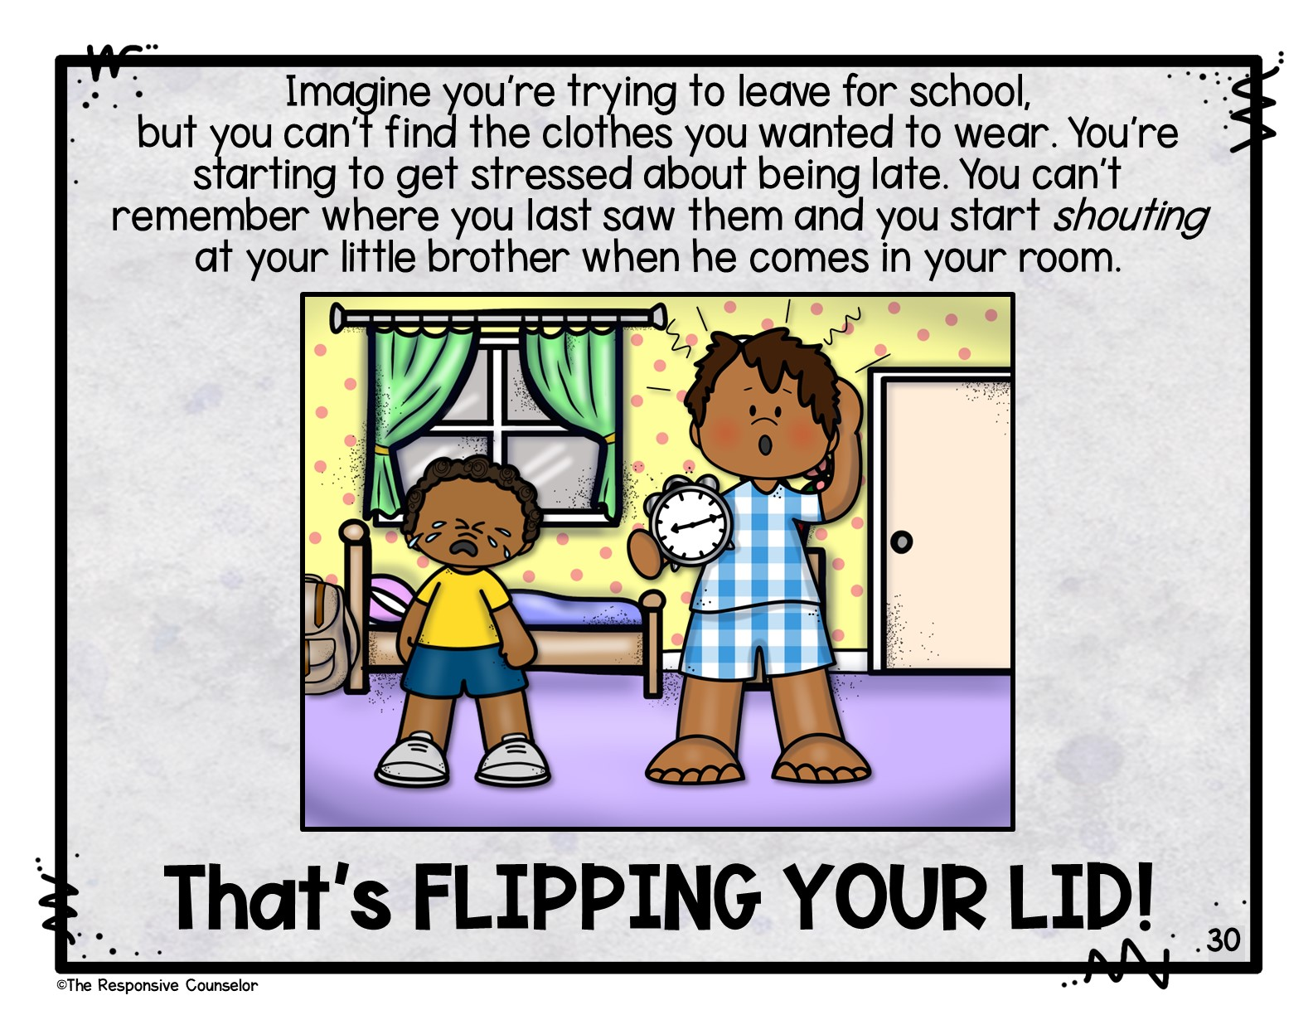
Notes:
Imagine you’re trying to leave for school, but you can’t find your backpack. You’re starting to get stressed about being late. You can’t remember where you last saw it and you start shouting at your little brother. That’s flipping your lid!

Slide 31
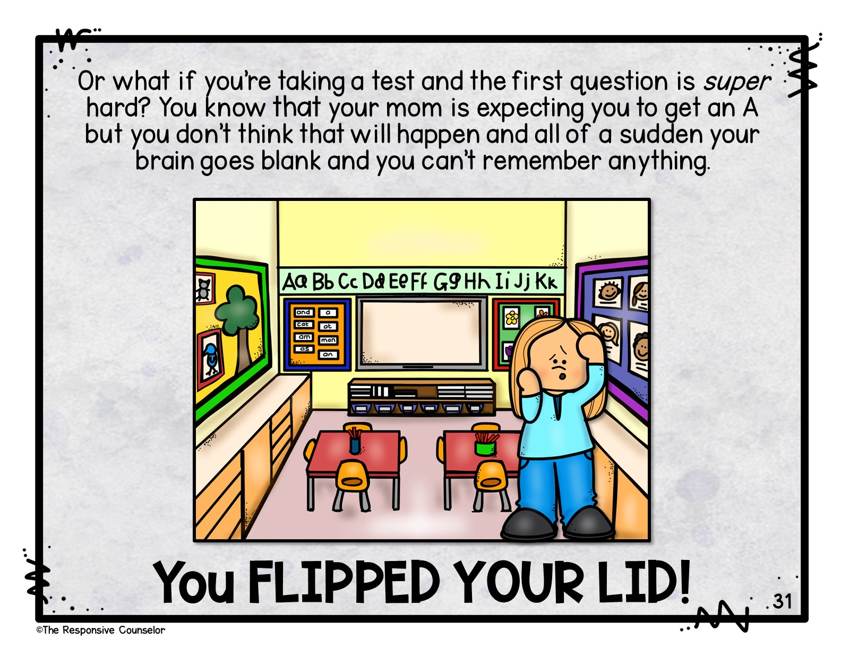
Notes:
Or what if you’re taking a test and the first question is super hard? You know that your mom is expecting you to get an A but you don’t think that will happen and all of a sudden your brain goes blank and you can’t remember anything. You flipped your lid!

Slide 32
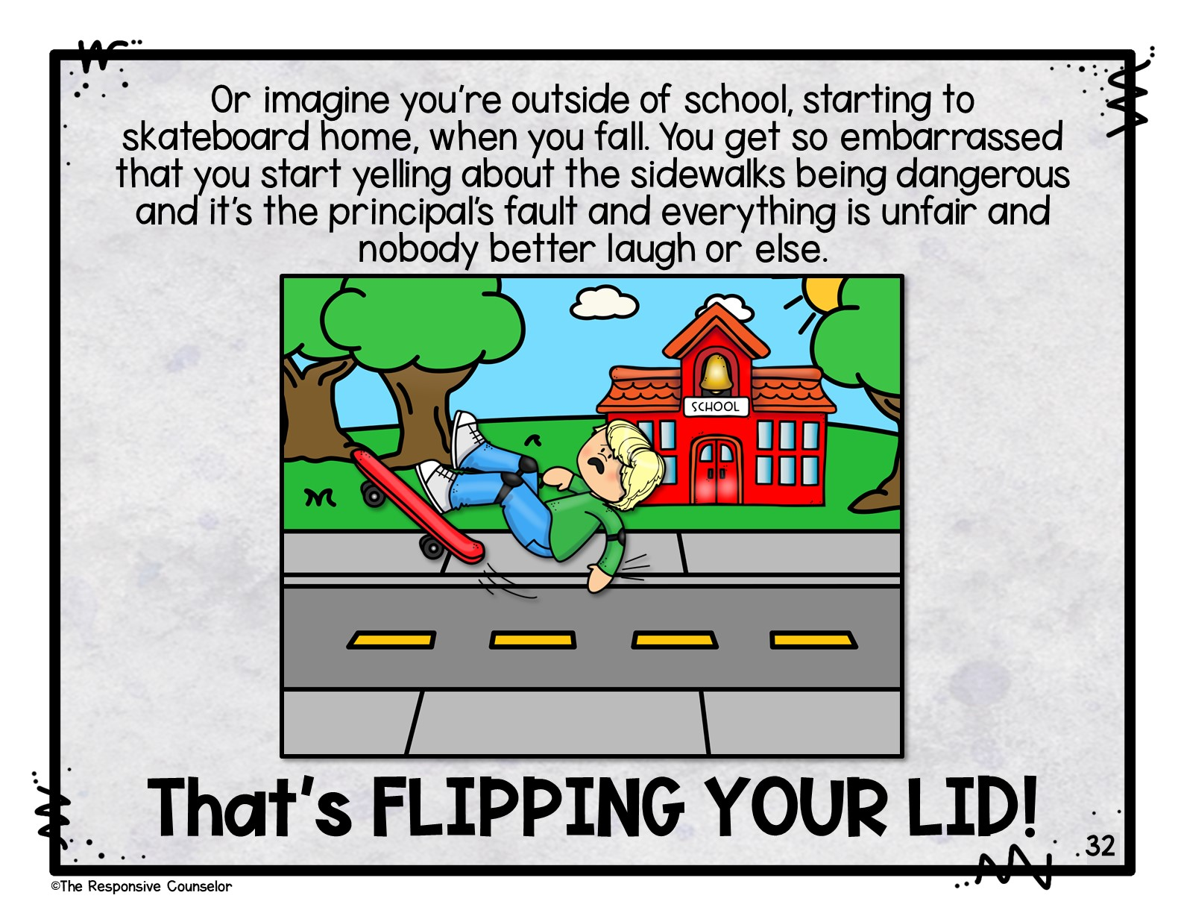
Notes:
Or imagine you’re outside of school, starting to skateboard home, when you fall. You get so embarrassed that you start yelling about the sidewalks being dangerous and it’s the principal’s fault and everything is unfair and nobody better laugh or else.

Slide 33
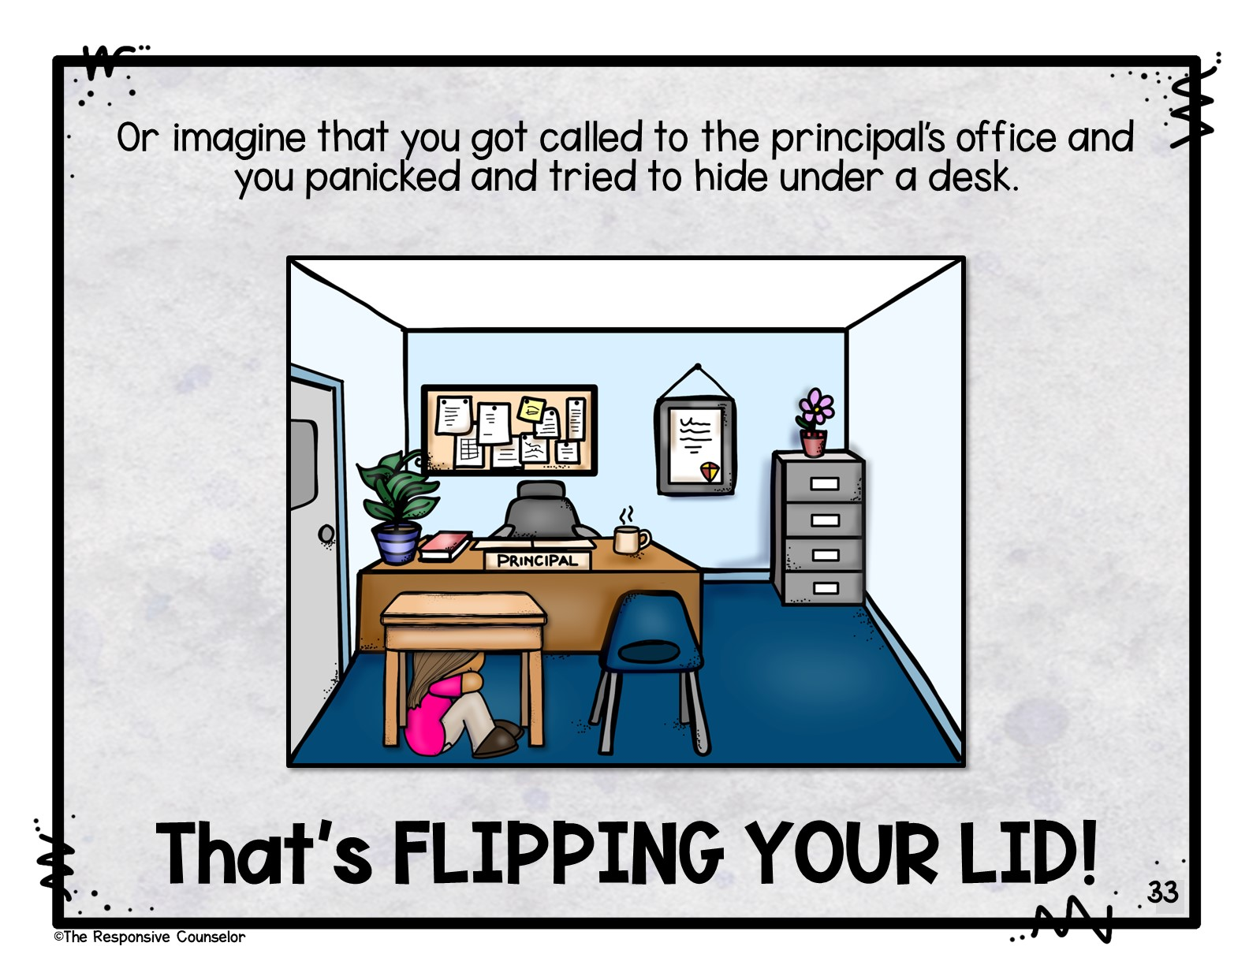
Notes:
Or imagine that you got called to the principal’s office and you panicked and tried to hide under a desk. That’s flipping your lid!

Slide 34
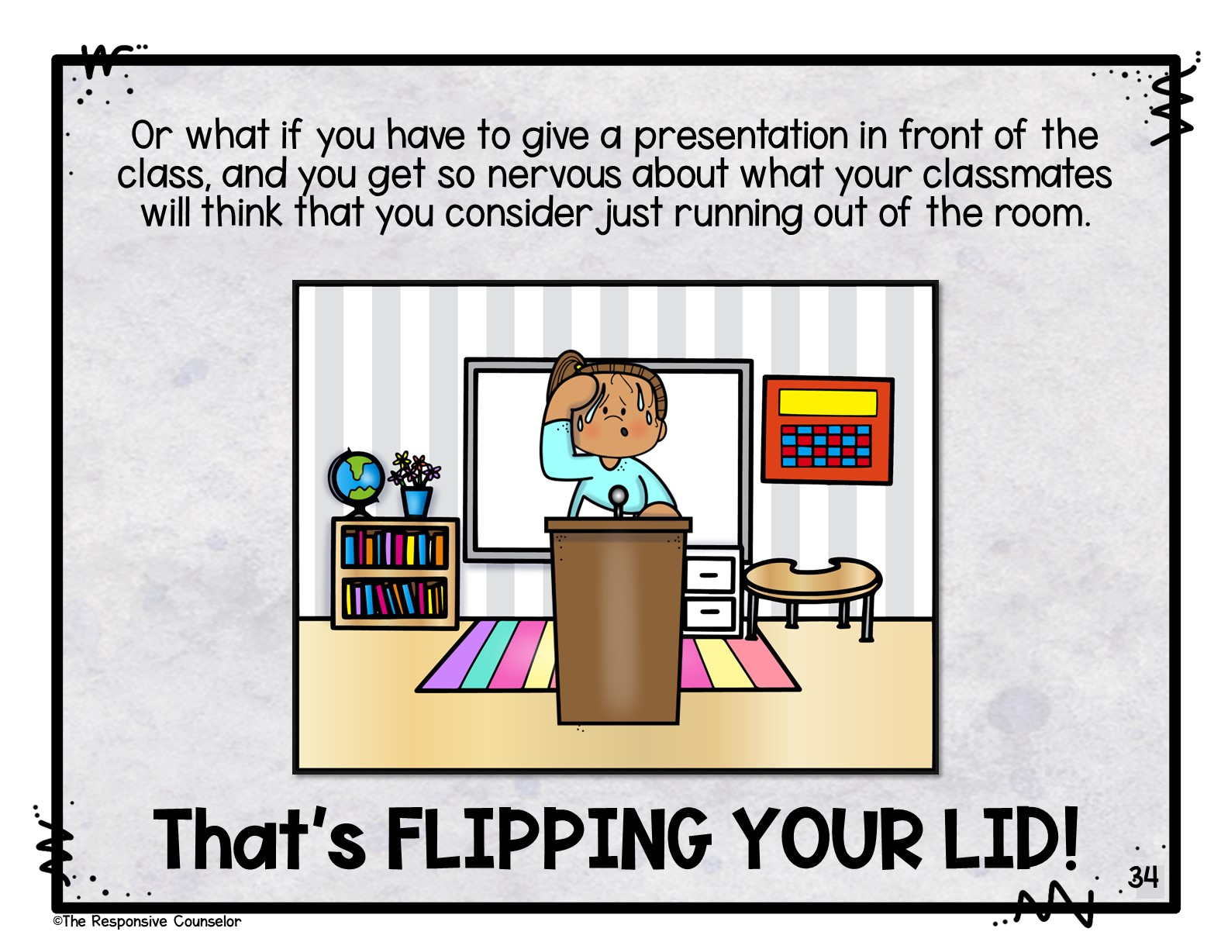
Notes:
Or what if you have to give a presentation in front of the class, and you get so nervous about what your classmates will think that you consider just running out of the room.

Slide 35
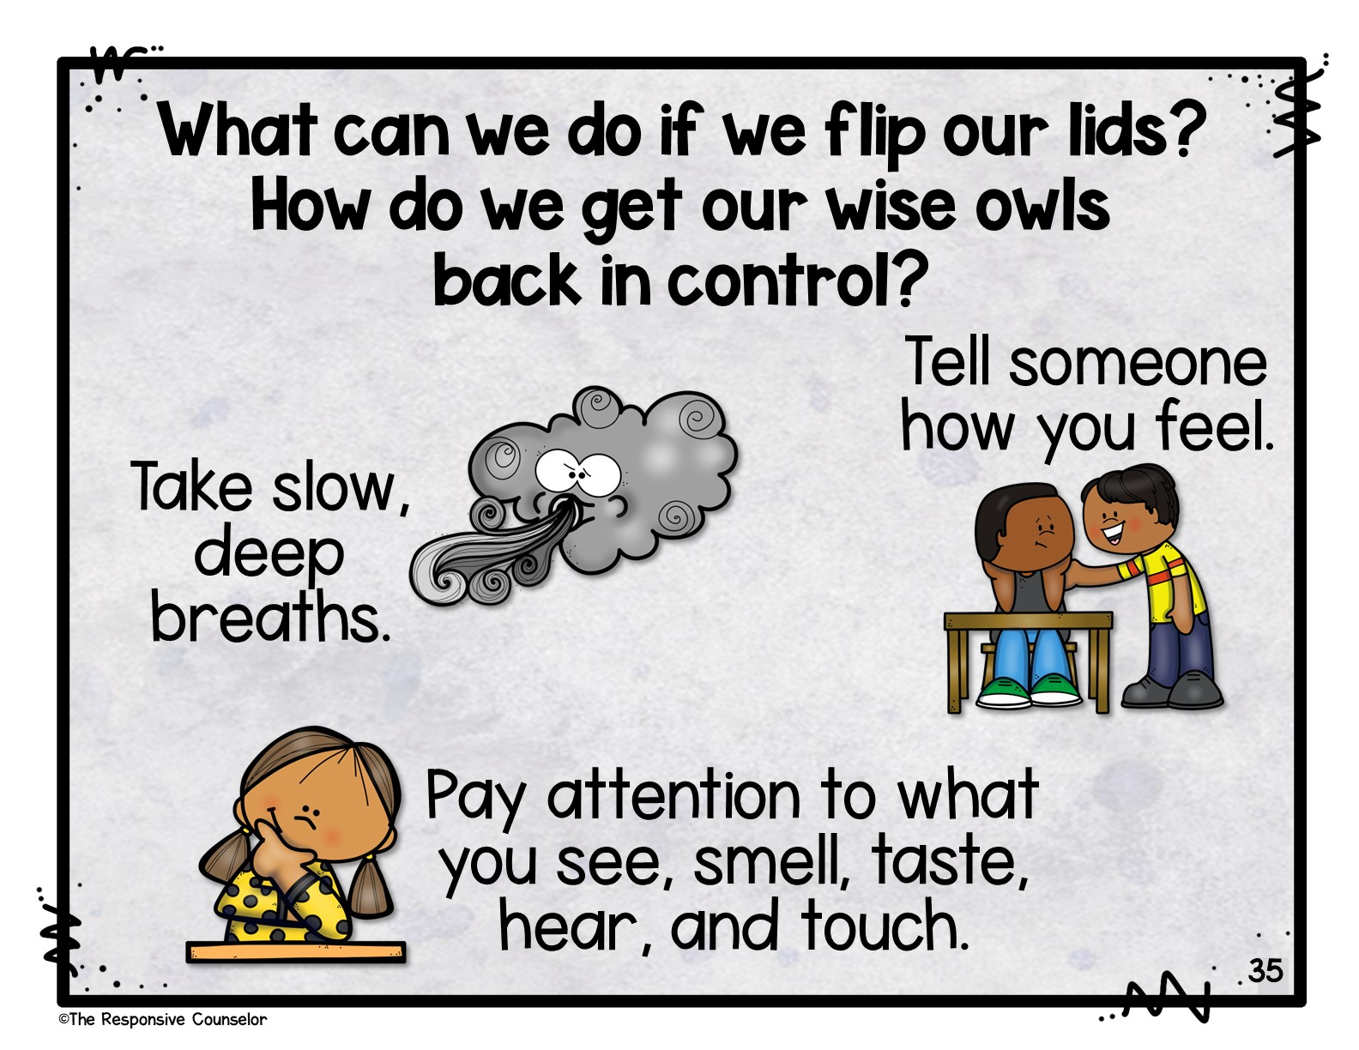
Notes:
What can we do if we flip our lids? How do we get our wise owls back in control? We can take slow deep breaths. You can tell someone how you feel. And we can pay attention to what you see, smell, taste, hear, and touch.

Slide 36
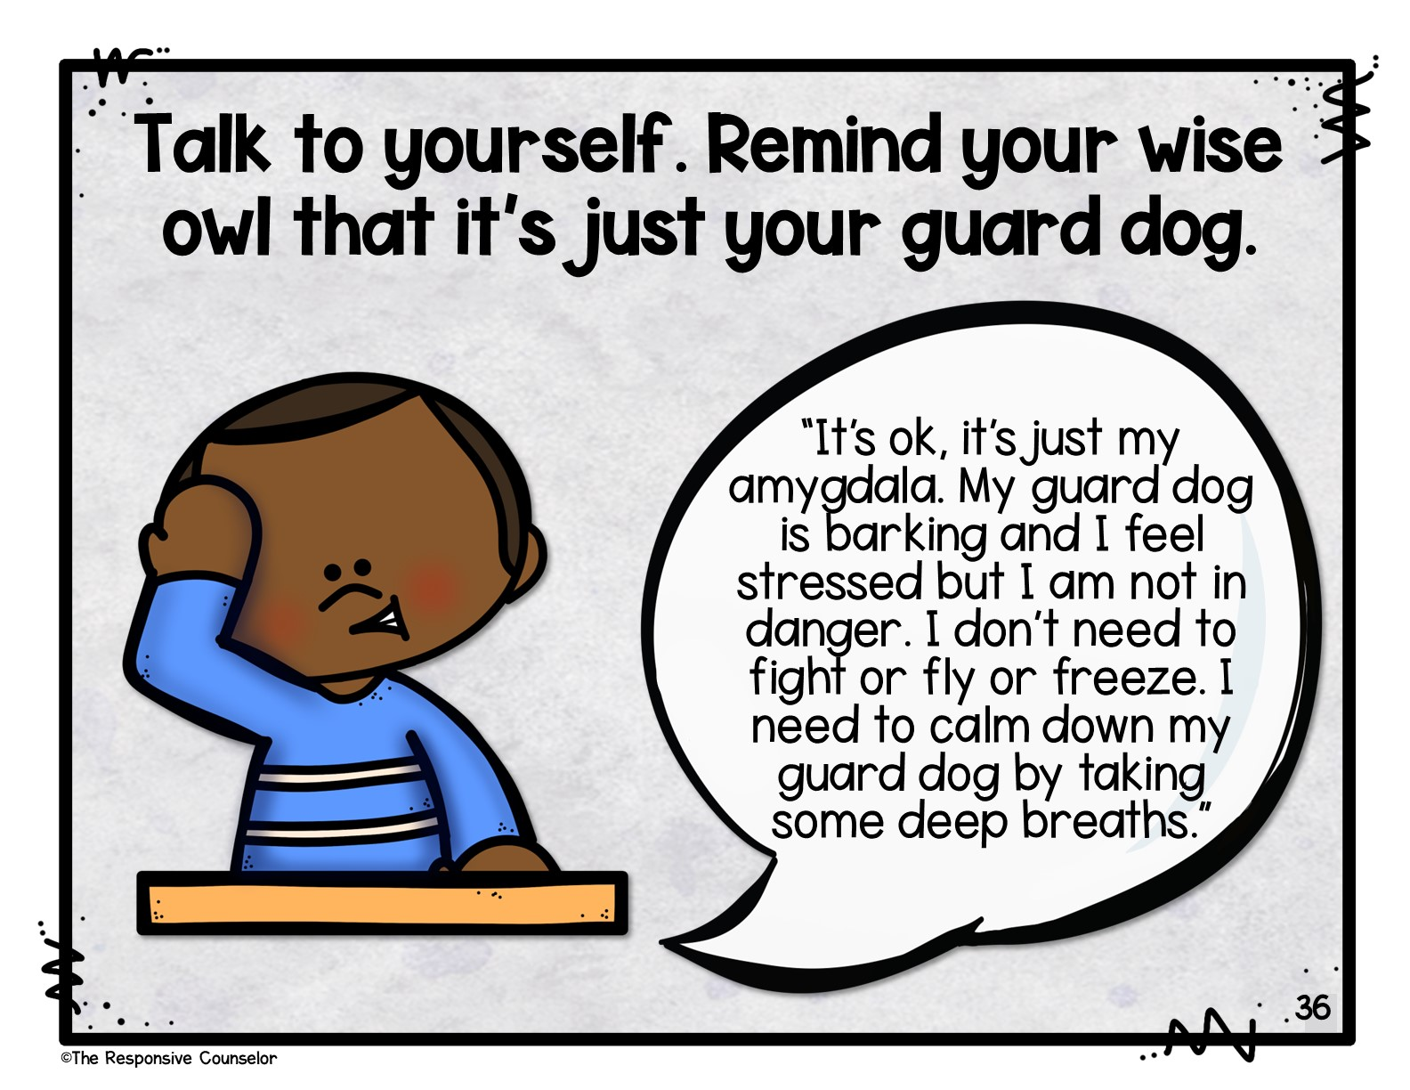
Notes:
You can also talk to yourself. Remind your wise owl that it’s just your guard dog. Like this boy thinking “It’s ok, it’s just my amygdala. My guard dog is barking and I feel stressed but I am not in danger. I don’t need to fight or fly or freeze. I need to calm down my guard dog by taking some deep breaths.” (If you’re doing the act aloud skits, this would be a great time for the second one!)

Slide 37
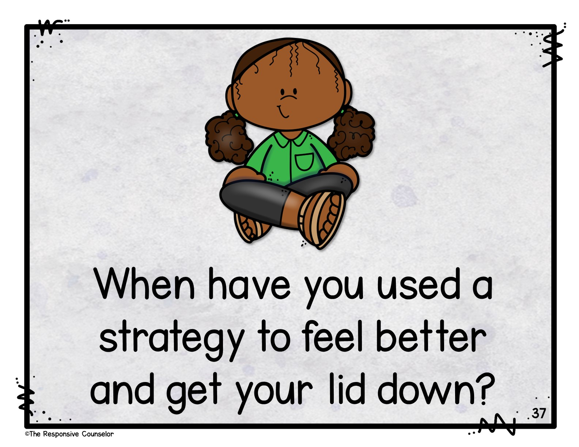
Notes:
When have you calmed yourself down when you were stressed? Turn and talk with a partner. (If you’re doing the self-talk or coping strategies activity pages, this would be a great time to do them!)

